Slide 1
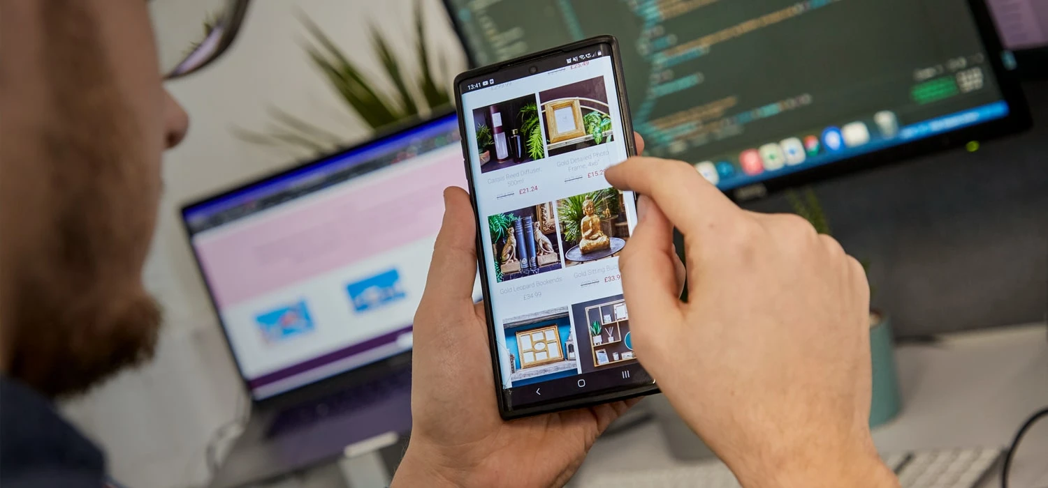
Screen Pages.
Mobile Commerce is exploding – are you ready?.
Sarah Willcocks – CEO & Owner .

Slide 2
Screen Pages Key Facts.
UK-based, privately owned, profitable business
Proven track record in D2C, B2B and B2C Integrated eCommerce
Specialists in UX, mobile first eCommerce and PWAs
Independently certified, highly skilled developers and solution specialists
One of the first Adobe / Magento solution partners in the UK
Over 300 Magento sites built since 2009
Recognised by the Magento Community as experts
Recognised by the ecosystem as experts in our field
www.screenpages.com/latest/videos

Slide 3
Mobile Commerce is exploding.
According to forecasts, retail sales from m-commerce in the United Kingdom are expected to surpass the 100 billion British pounds mark by 2024. This coincides with the high percentage of people using mobile devices.
In the UK, close to 100 percent of individuals between the ages 16 and 24 owned a smartphone in 2022.
Mobile phones accounted for over 70 percent of online visits to retail websites.
Recent survey data indicated that smartphones were the favored shopping device, preferred by nearly seven in ten British online shoppers.
Smartphones also serve as the key connection with in-store purchases and payments. Many UK consumers enjoy the advantage of paying with their phones.
Published by Statista Research Department, Jan 18, 2023

Slide 4
However.
The smaller the screen size, the larger the cart abandonment rate
Despite more users using mobiles to make purchases, they are more likely to fail to complete purchases compared to desktops and tablets
Data Source: Barilliance

Slide 5
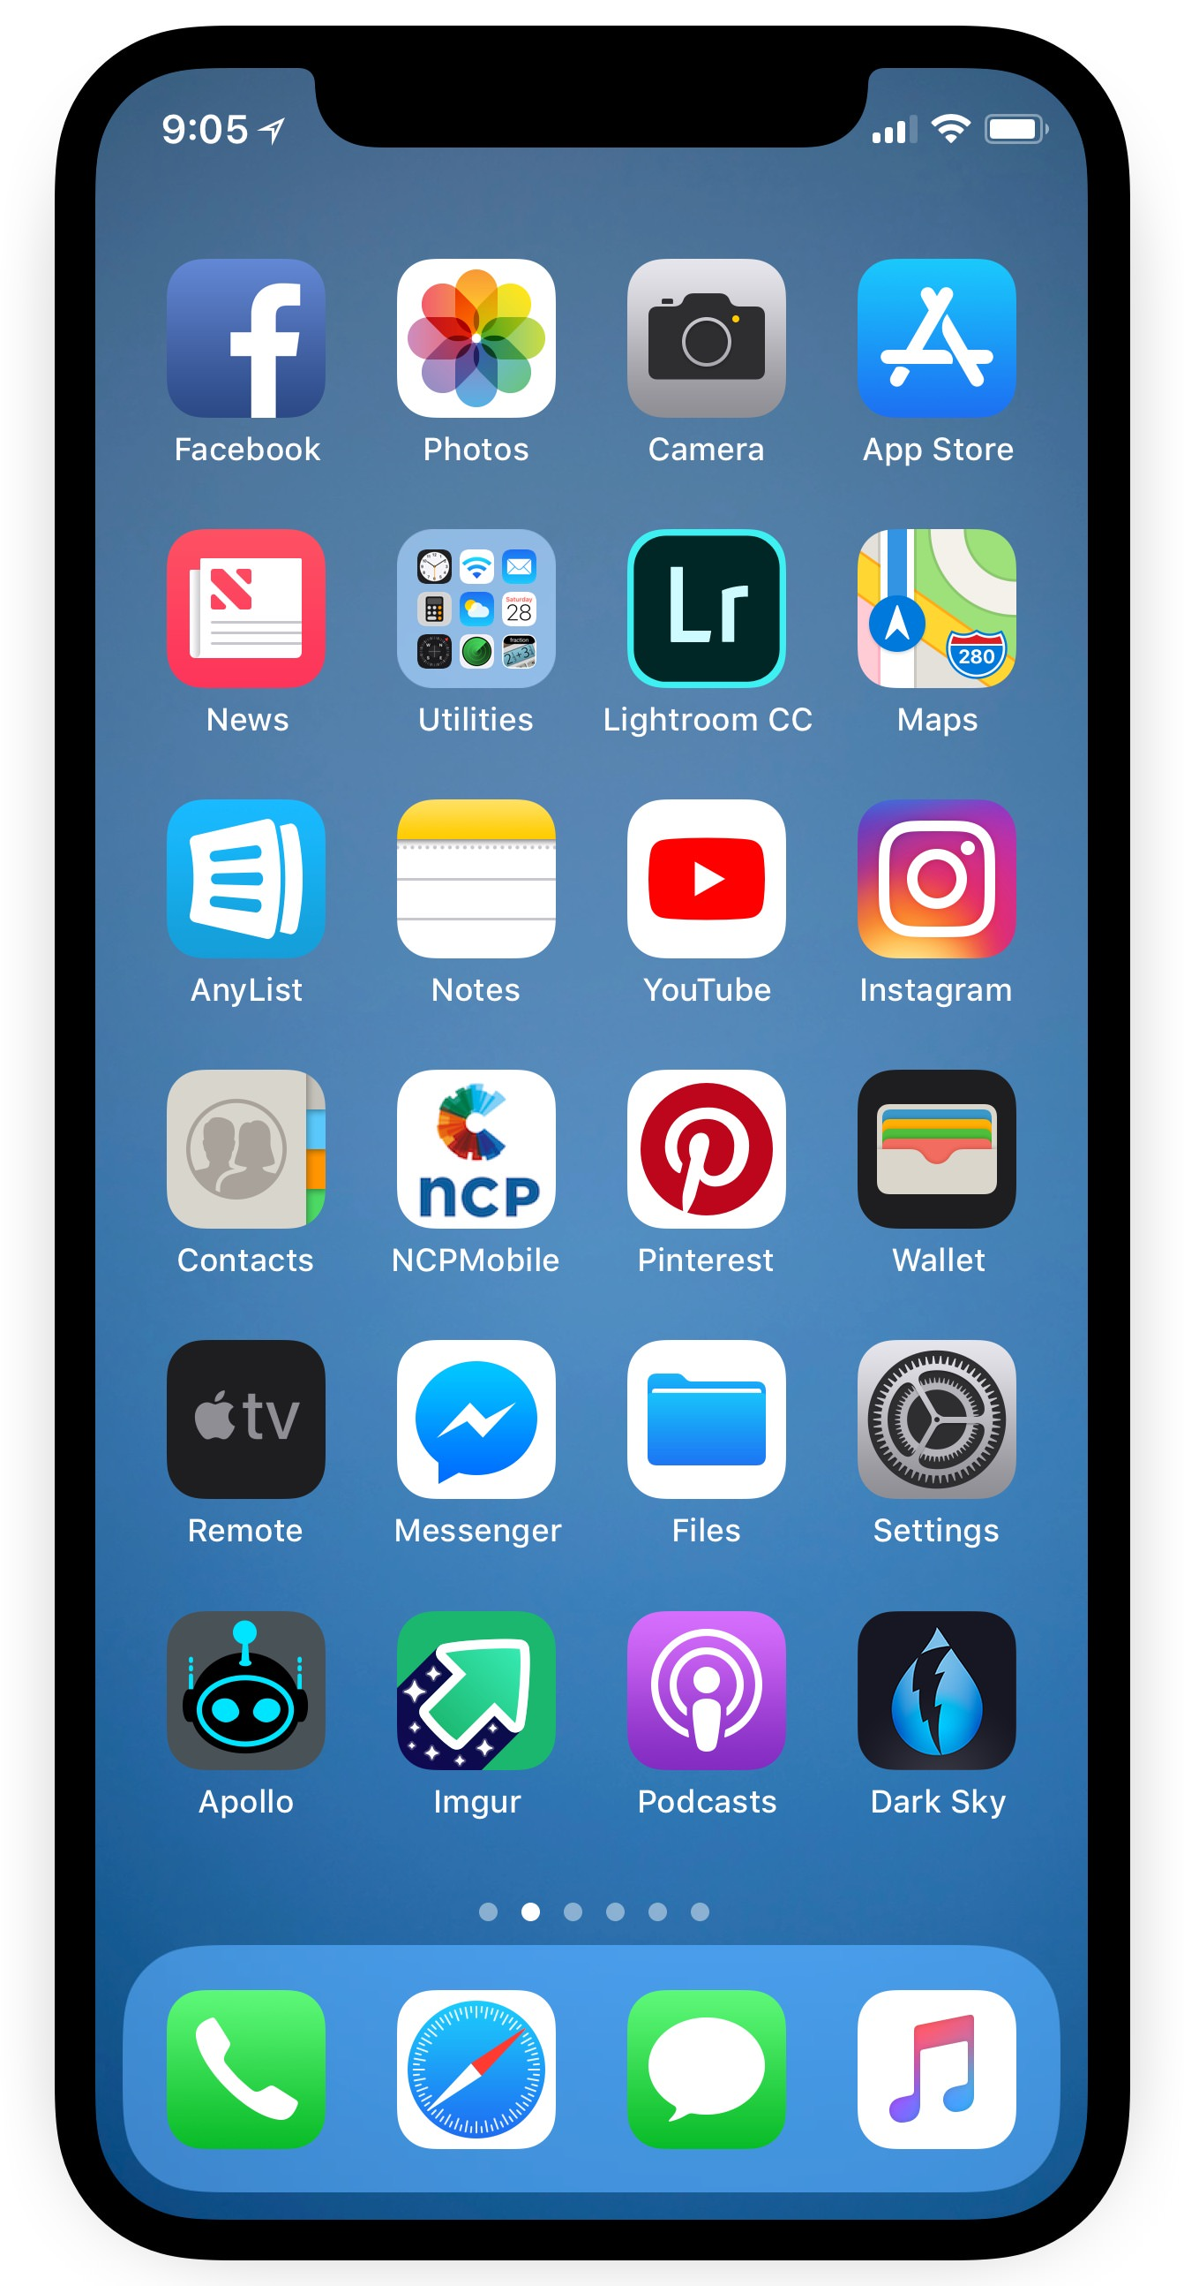
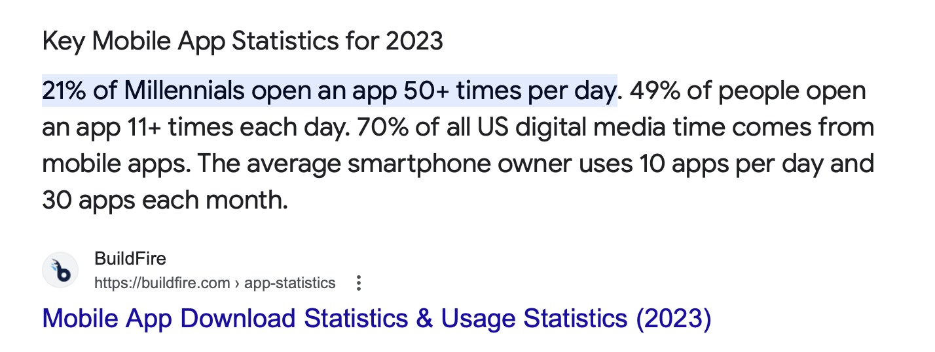
What about mobile apps.
They’re great because you can deliver in app and push notifications to customers
They can make use of on-device features such as camera etc
They work offline (partially)
They are faster
They are always there on the customers device
= More customer engagement and better conversion rates as a result

Slide 6
So why not just build a mobile app?

Slide 7
It’s not that easy.
The smartphone marketing is extremely fragmented, so it is nigh on impossible to offer an app that works consistently across all devices

Slide 8
Apps require more work.
They are not a substitute for a website
They are costly to maintain because you need more than 1 (Android and iOS)
They cannot be indexed by search engines
You’ll have increased marketing spend
Changes / updates need to be submitted and approved by the app store and Google play store
They use up memory on your customers phones

Slide 9
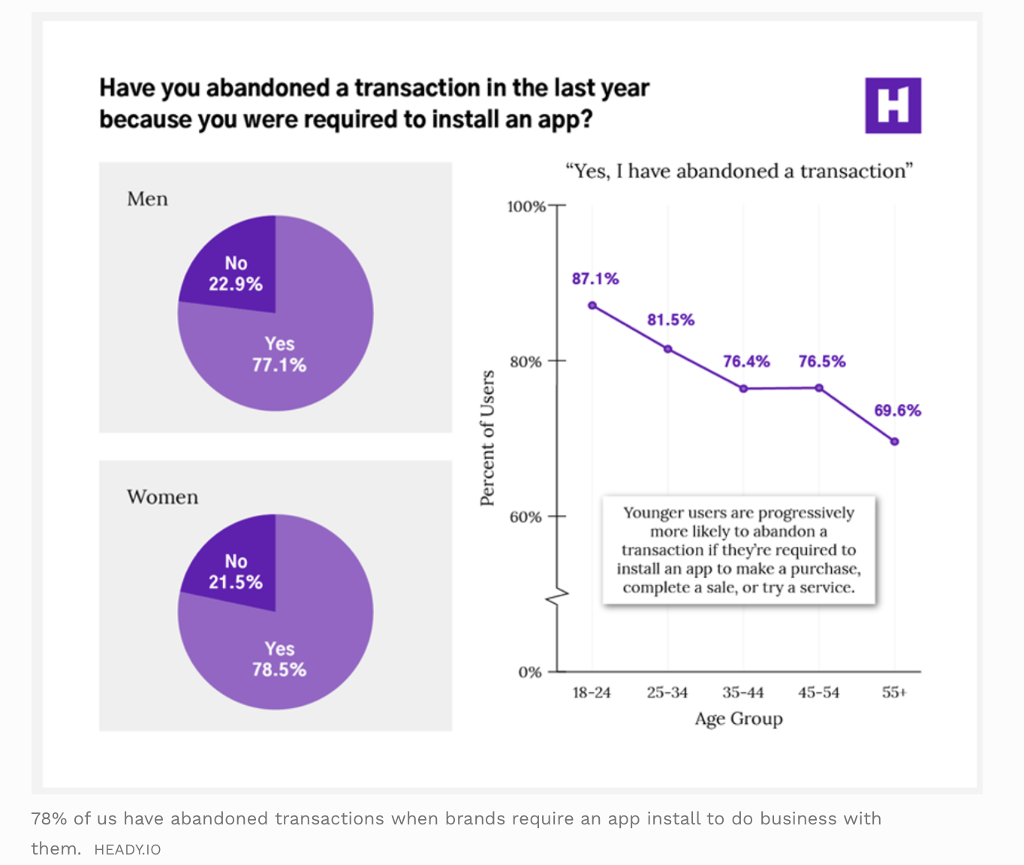
Not all customers want them.

Slide 10
So what are my options.
Look at ways to improve the speed of your site
Explore how to improve the mobile UX of your site
Check what devices / browsers are most commonly used and focus on those
Improve your search – it’s more widely used on mobile
Use defaults on the checkout – e.g. delivery address same as invoice
Offer mobile friendly payment options

Slide 11
Or think about a PWA.
Progressive Web Applications (PWAs) are web applications that load like regular web pages or websites but can offer the user functionality such as working offline and push notifications, traditionally available only to native applications
wikipedia.org/wiki/Progressive_web_applications
Originally proposed by Google in 2015 they have already attracted a lot of attention because of ease of development and benefits to end users

Slide 12
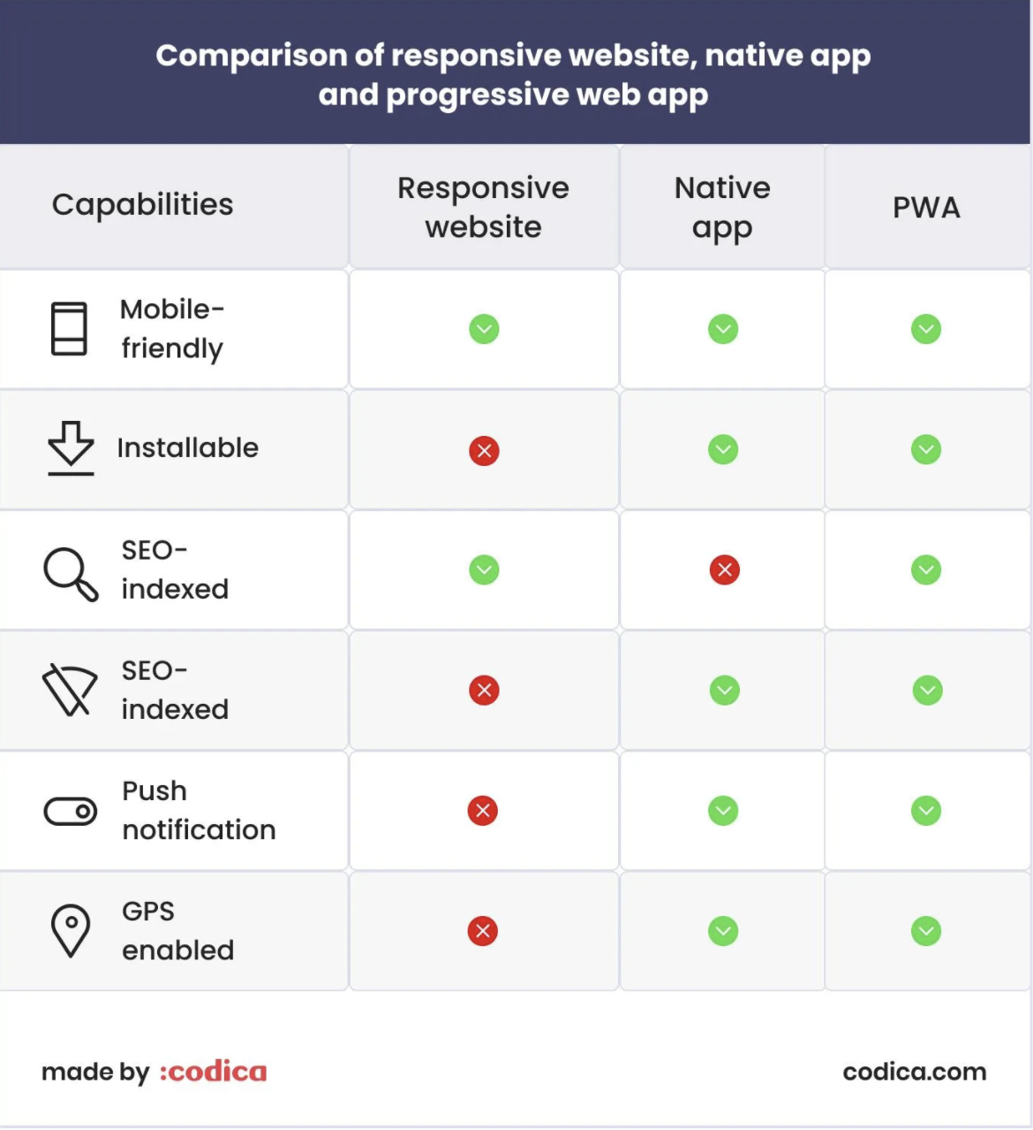

Slide 13
Morland UK.

Slide 14
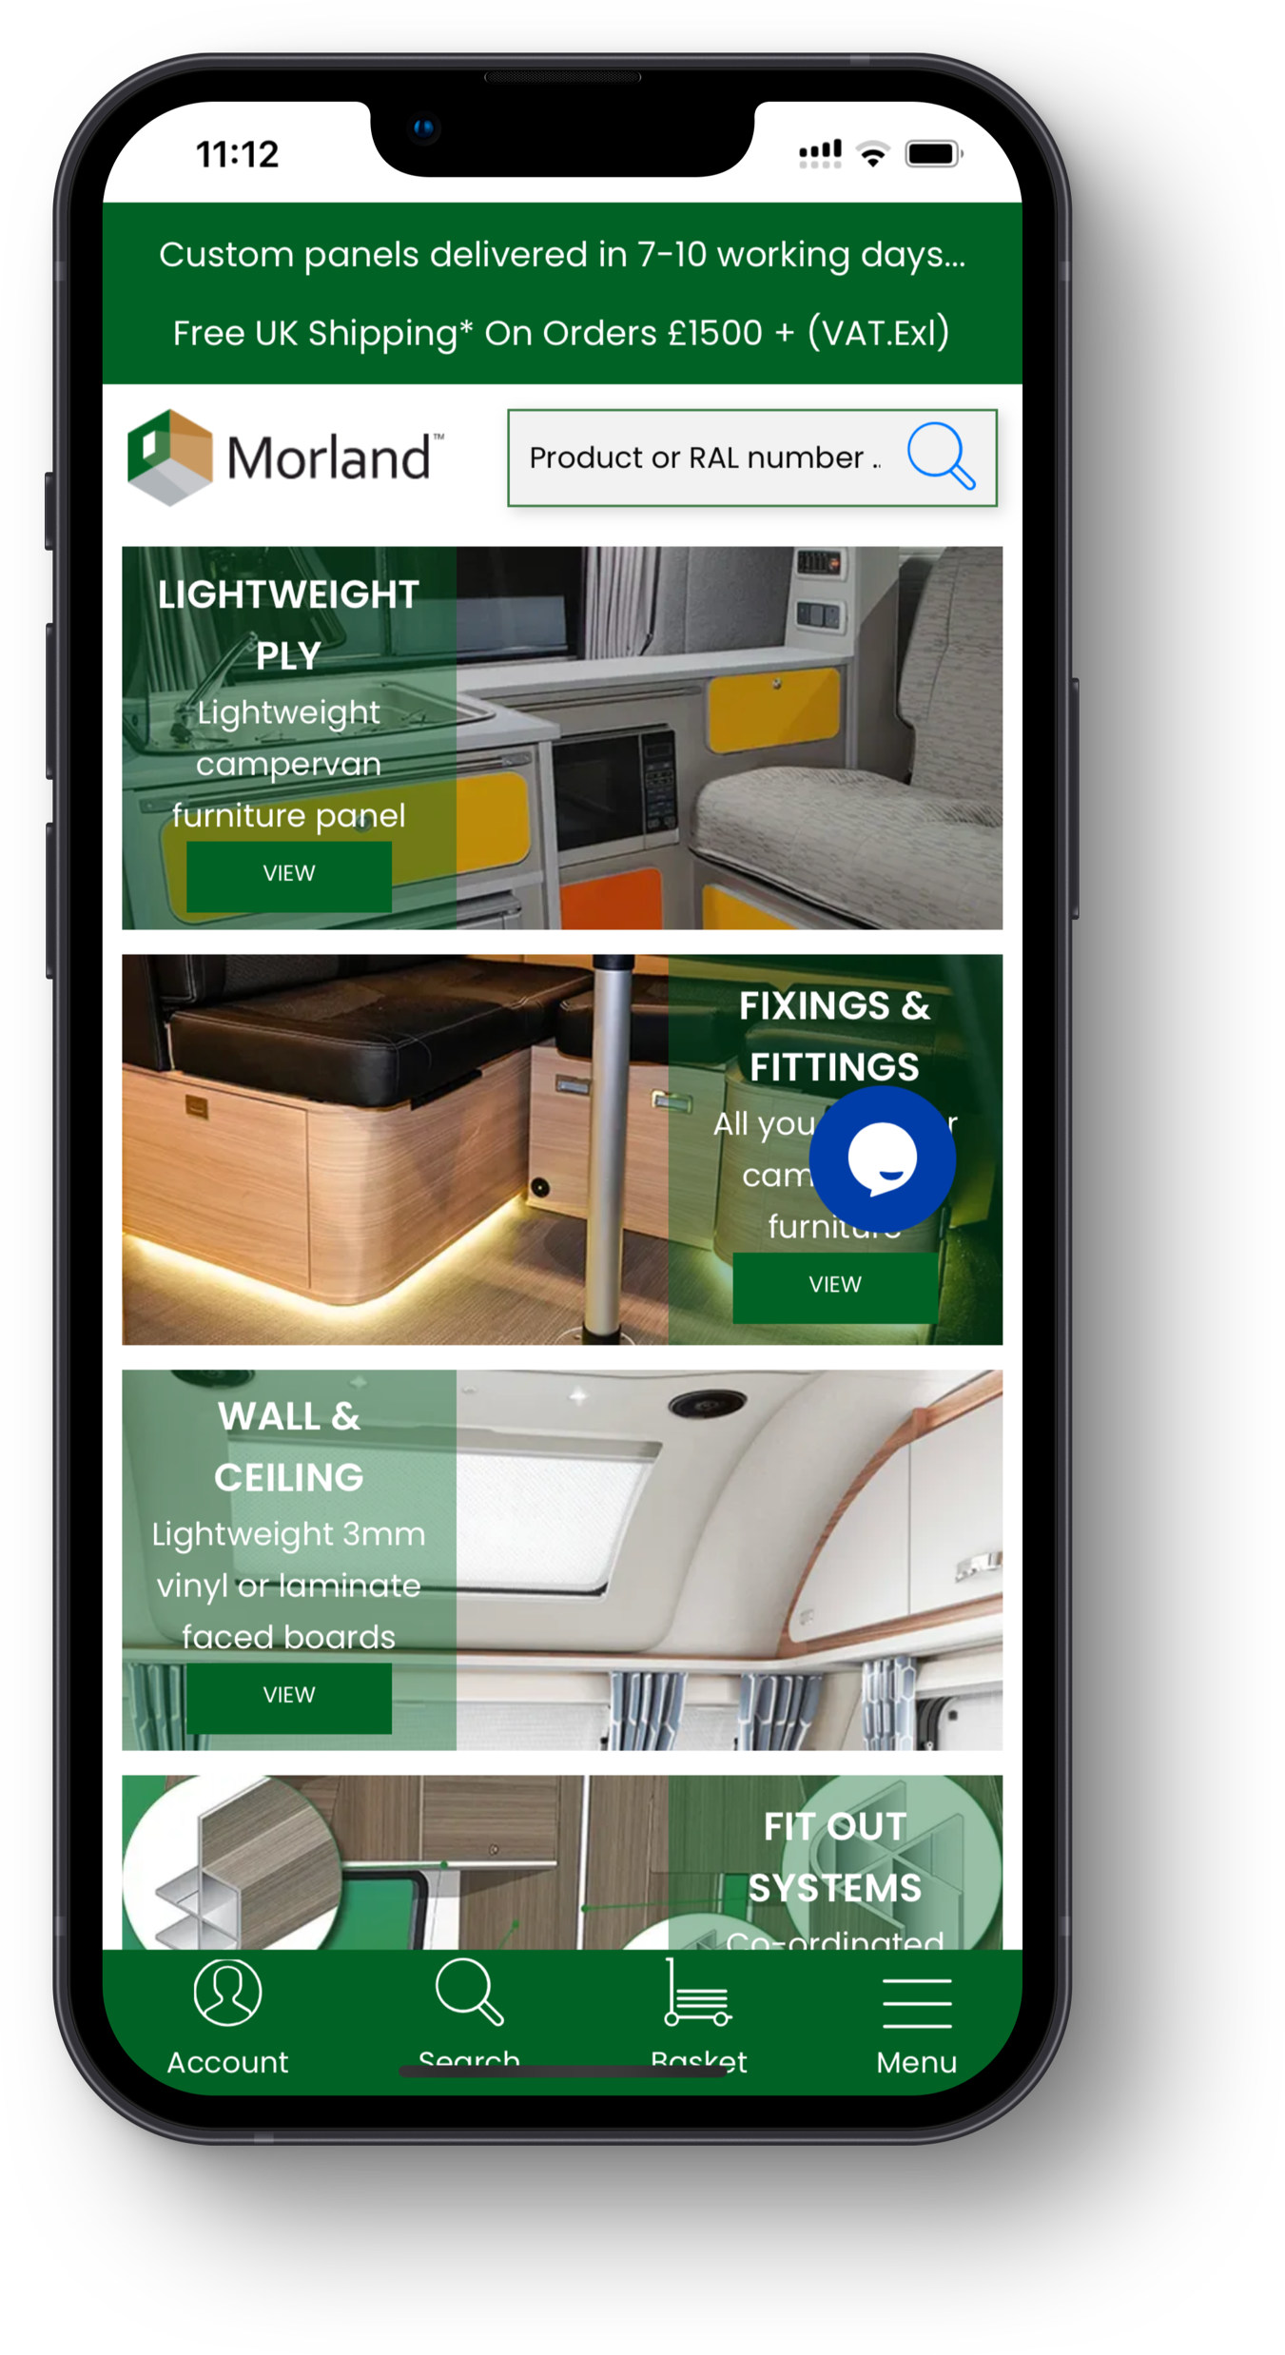
Goals for the PWA.
Provide best practice UX and CS to all customers across all devices to improve conversion
Deliver D2C and B2B eCommerce sites in 2 languages and 2 currencies on one single platform – Adobe Commerce Cloud
Provide an app-like user experience on mobile devices via the implementation of a PWA front end using ScandiPWA (https://scandipwa.com)
Fully integrate the site with MS Dynamics for true omnichannel retailing
Expand self-servicing options for trade customers ordering online
Improve fulfilment options for customers via integration with ShipperHQ (https://shipperhq.com)
Increase engagement and conversion on the site via integration with Yotpo (https://www.yotpo.com) for reviews, recommendations and user generated content
Improve search and merchandising via integration with Klevu (https://www.klevu.com)
Implement personalised automated marketing programmes for a variety of different customer types by integrating Dotdigital (https://dotdigital.com) with Adobe Commerce Cloud

Slide 15
Keakado.

Slide 16
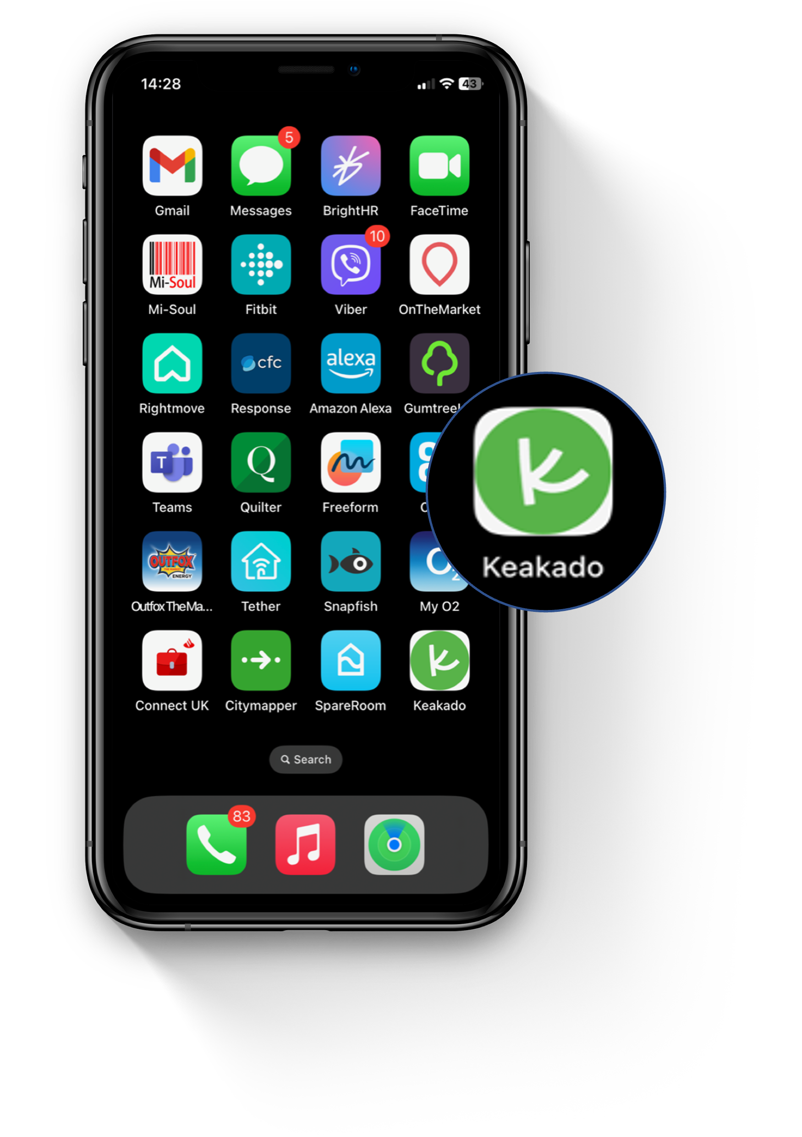
Keakado Results.
First D2C site for FMCG wholesaler and distributor
Commissioned in April 2020 and launched in August 2020
73% visitors from mobile devices
15.5% average conversion since launch
Bounce rate 20% lower than average
“We chose Screen Pages because of their integrity and consultative approach. We are very proud to have created one of the first PWAs in the Middle East and we look forward to seeing how our customers enjoy this exclusive experience.”

Slide 17
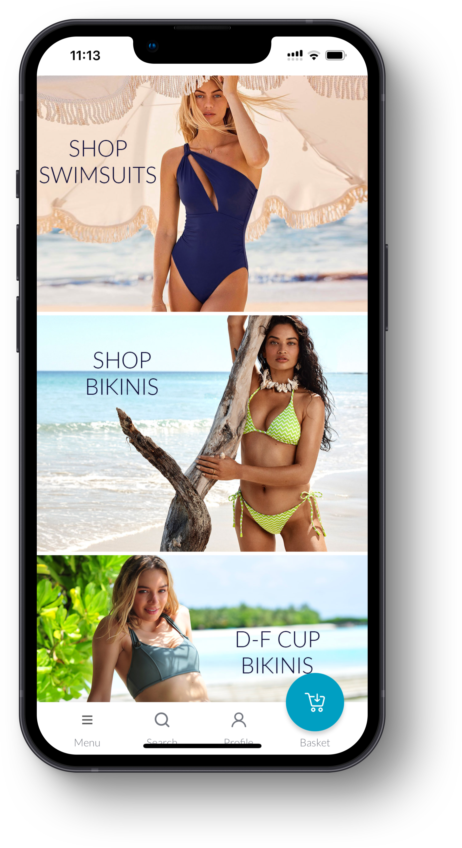
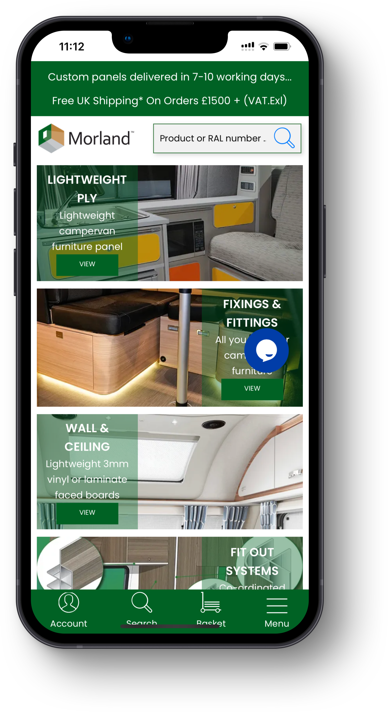
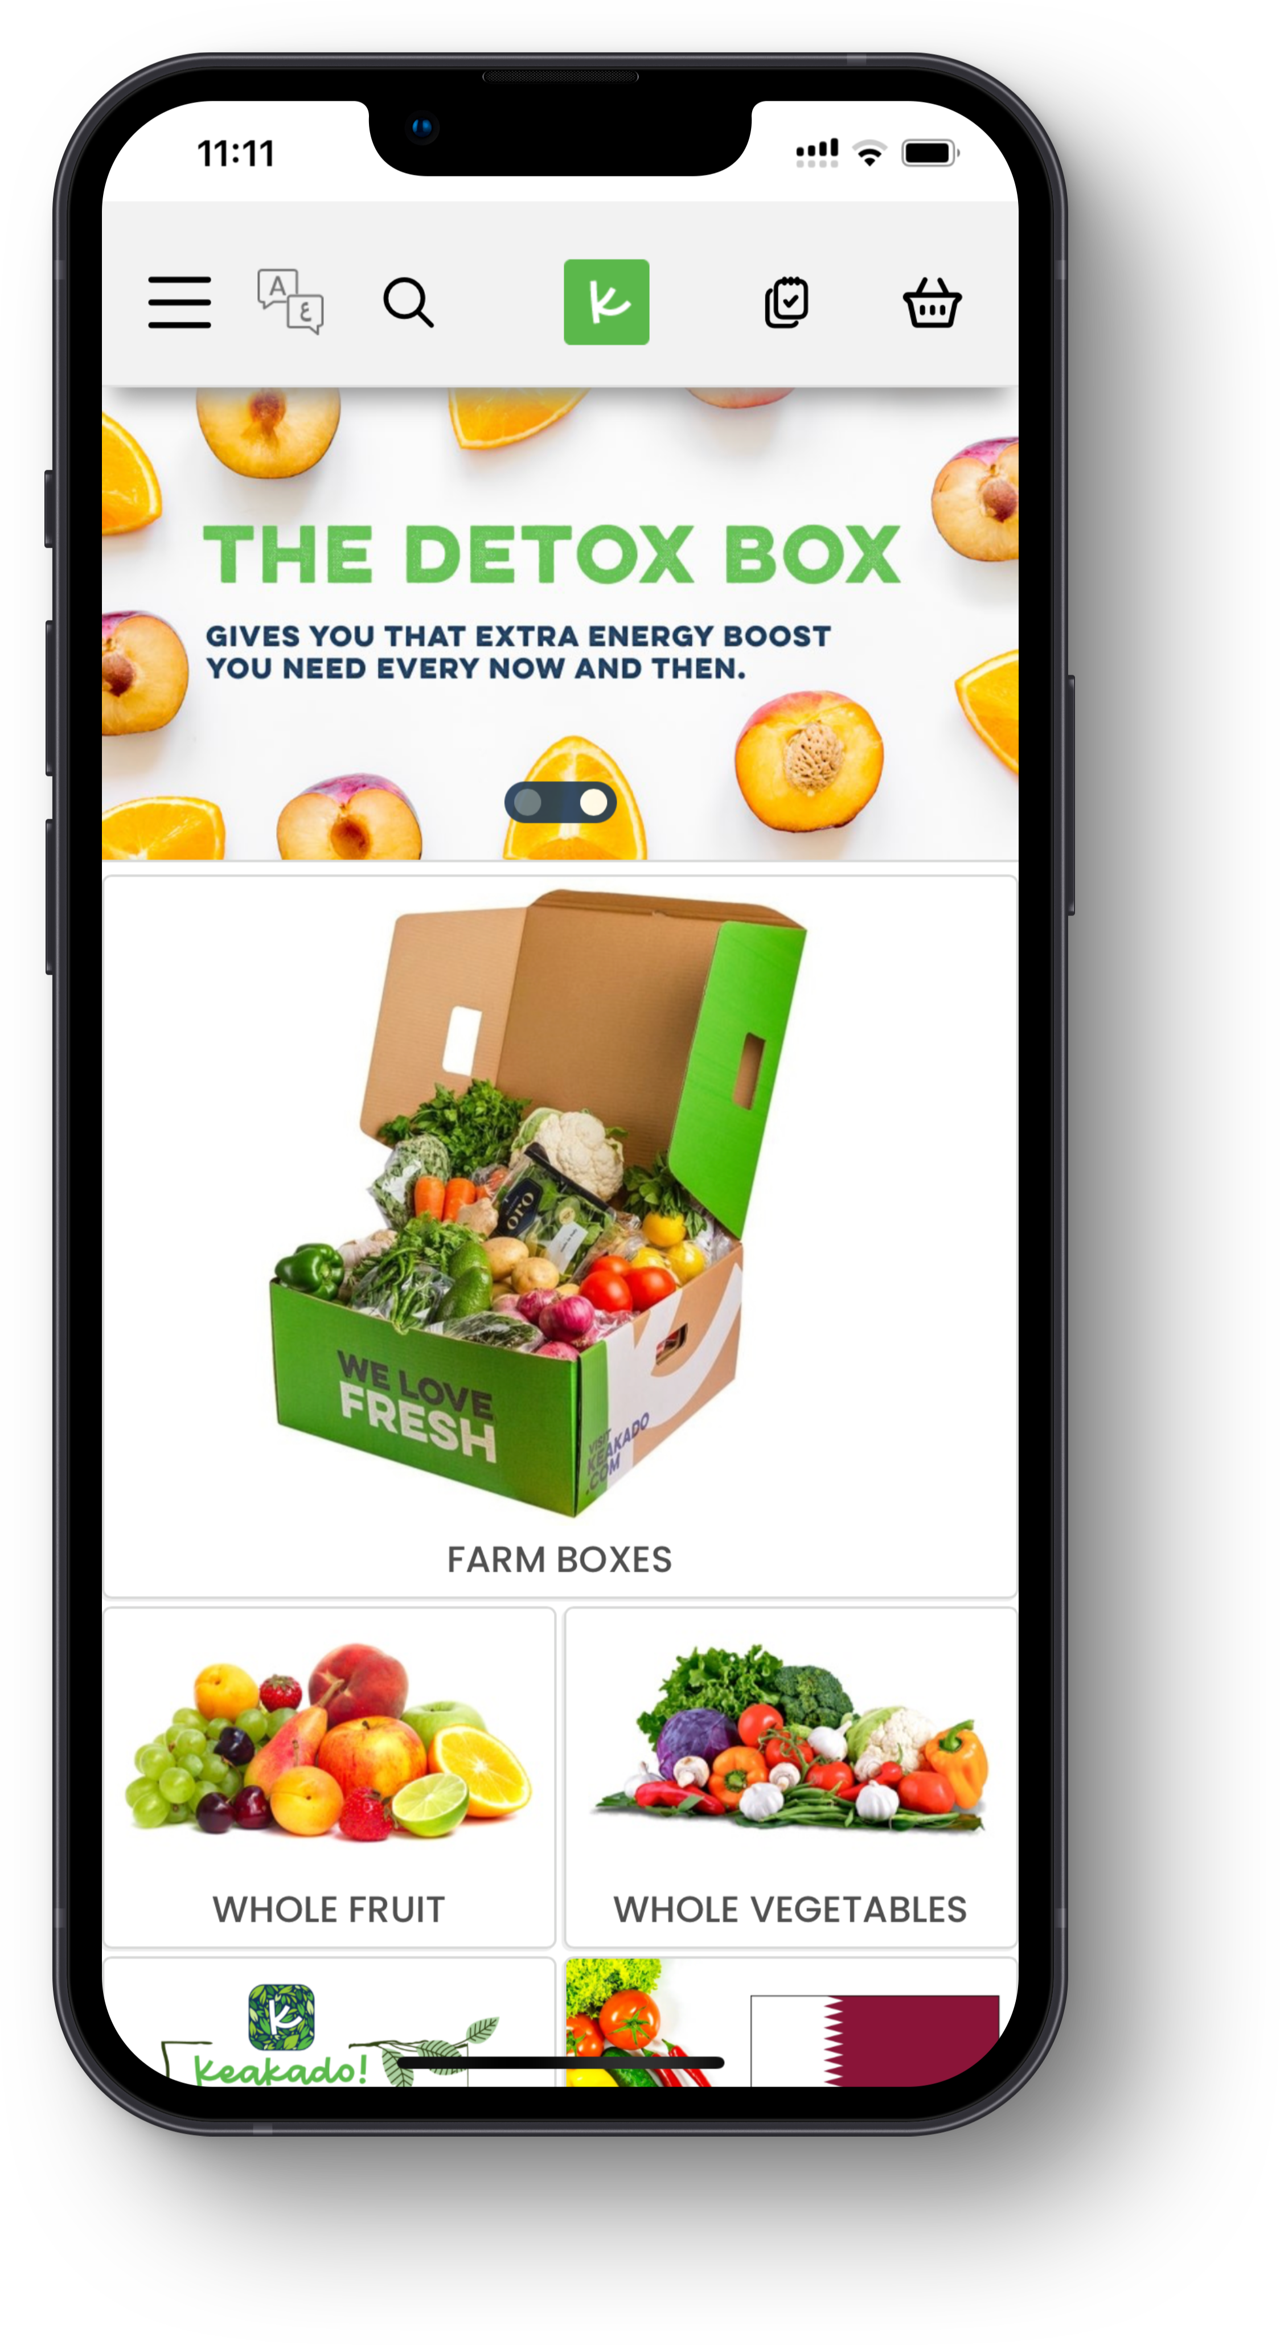
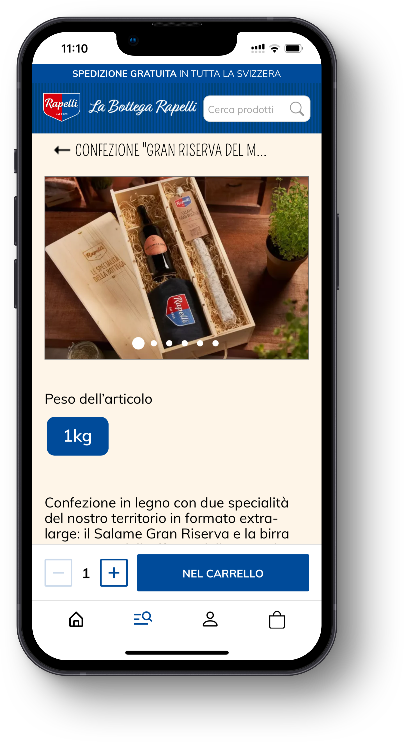
PWAs are great because.
PWAs load 2 to 10 times faster than mobile sites
Have offline capability
Can be added to a home screen without ever requiring updating
Allow push notifications
PWAs transfer the workload to the device instead of relying on the web server
Search engine friendly because they are websites not apps
Linkable – the web app retains its state when the user bookmarks or shares a URL
They contribute to a sites organic SEO, provided they are hosted over HTTPS

Slide 18
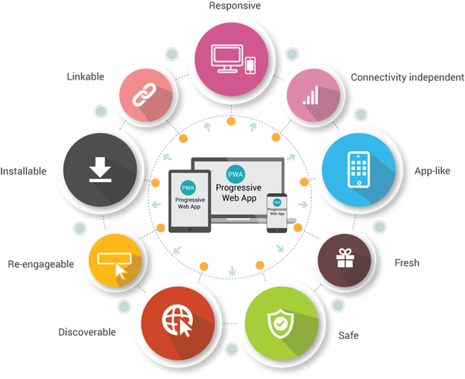
Conclusion.
Take a mobile first approach to your marketing, your website and your customer service
With limited real estate of mobile – UX is the most important thing to focus on
UX is not the same as ‘design’ – the prettiest website is not always the easiest to use
Take an iterative approach and tackle the low hanging fruit first
Be realistic – look to reduce the conversion gap – you cannot remove it completely
Consider a PWA

