Slide 1
Product Discovery Audit Report
An Expert Level Review of the Mobile Search and Product Discovery Experience
Brought to you by Klevu
WWW.KLEVU.COM

Slide 2
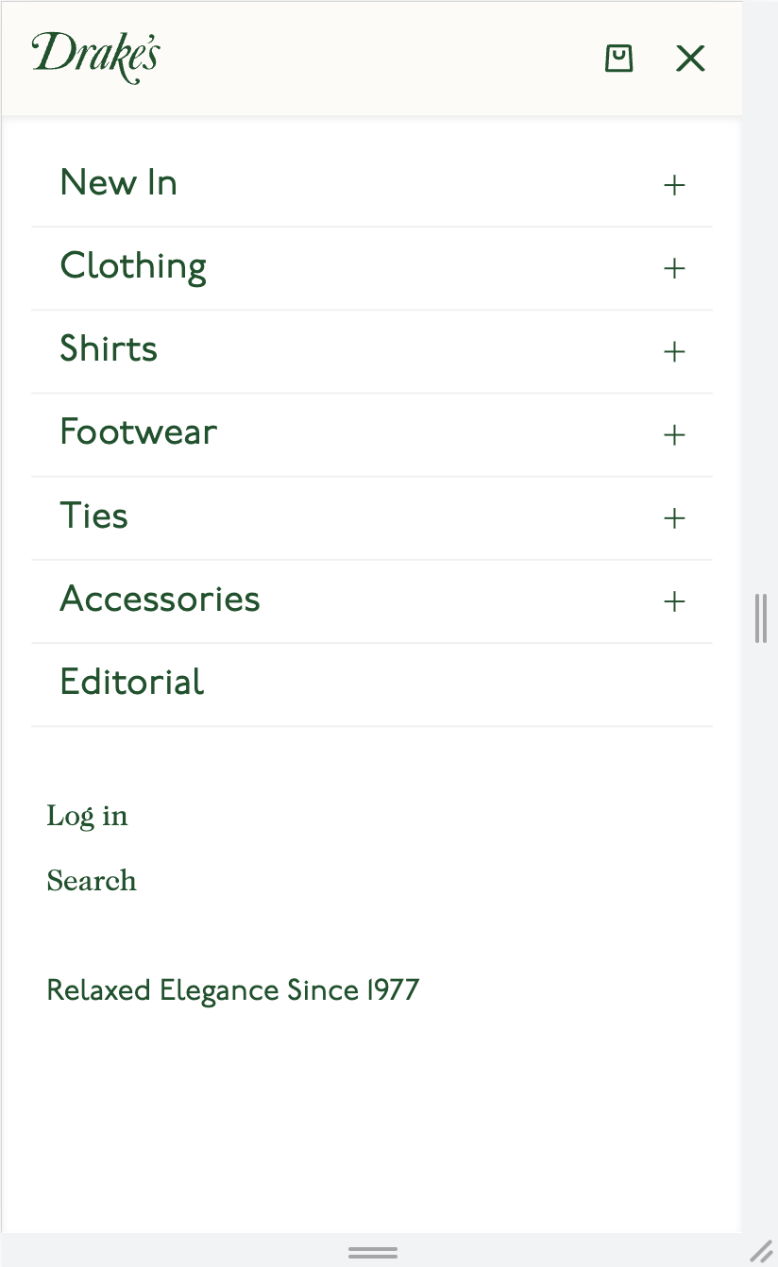
Actionable Improvements
Exposing the search bar
Drakes does not have a prominent search CTA
Over 40% of shoppers go immediately to the search bar when on a new website, this is especially relevant on mobile.
Brought to you by Klevu

Slide 3
Actionable Improvements
Actionable Improvements
Exposing the search bar
Goodhood has visually prominent search bar, with pretext making it easier to find
Over 40% of shoppers go immediately to the search bar when on a new website, this is especially relevant on mobile.
Exposing the search bar on your website can lead to a 44% increase in orders, especially on mobile.
Brought to you by Klevu

Slide 4
Actionable Improvements
Adding auto-suggest on search overlay when customer clicks on search bar
Drakes has no auto-suggest displayed when customer clicks on search bar
Brought to you by Klevu

Slide 5
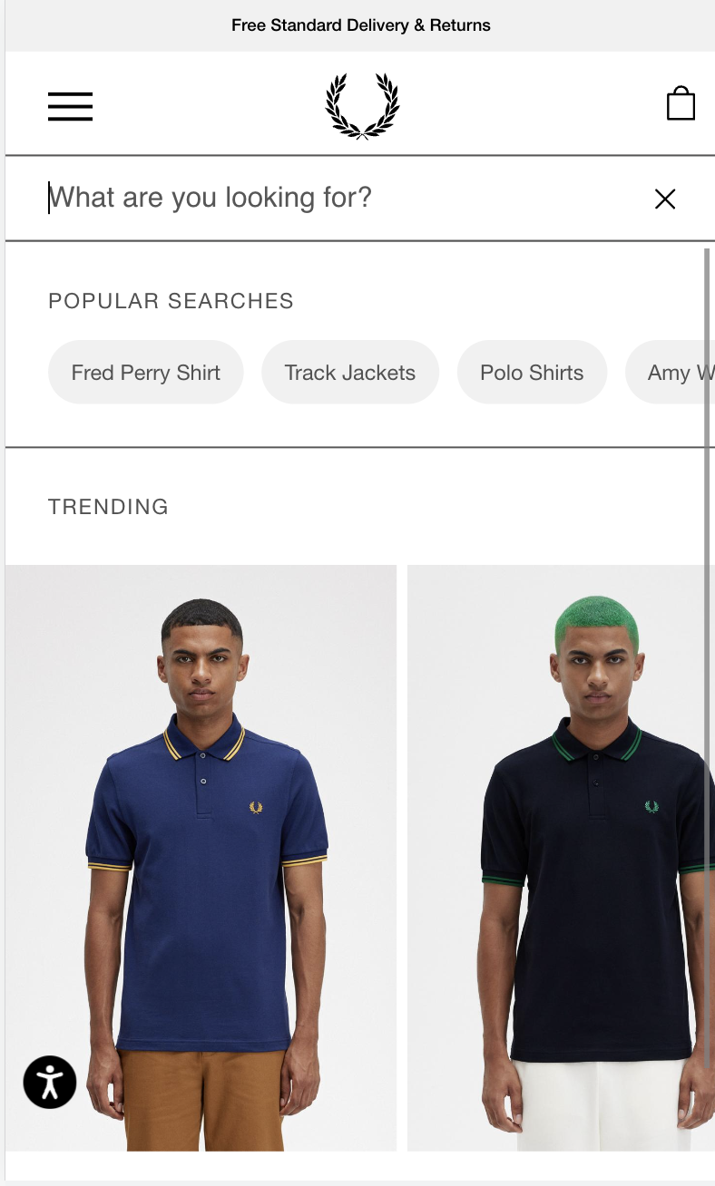
Actionable Improvements
Adding auto-suggest on search overlay when customer clicks on search bar
Fred Perry has auto-suggest displayed when customer clicks on search bar
For an optimum experience, show rich content within the search overlay including product recommendations, popular categories, popular searches and useful pages
Brought to you by Klevu

Slide 6
Actionable Improvements
Adding auto-suggest on search overlay when customer starts typing
Drakes currently only no auto-suggest when searching for products i.e ‘t-shirt’.
Brought to you by Klevu

Slide 7
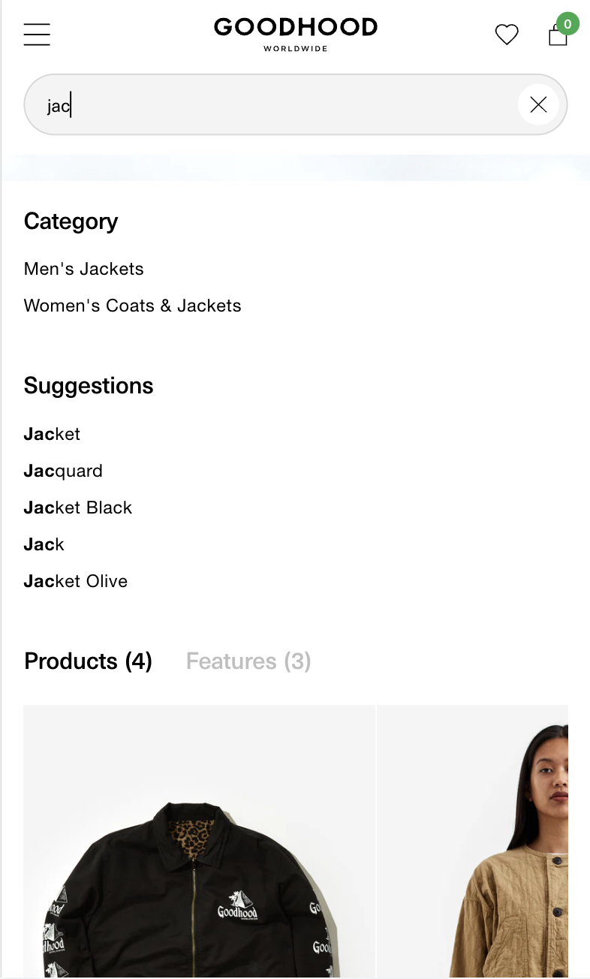
Actionable Improvements
Adding auto-suggest on search overlay when customer starts typing
Goodhood currently has auto-suggest when beginning search for products i.e ‘jacket’.
For an optimum experience, show rich content within the search overlay including relevant content, products, category pages, search suggestions
Brought to you by Klevu

Slide 8
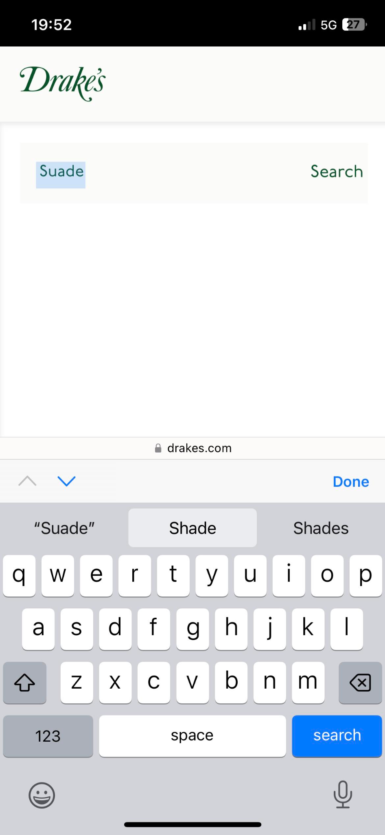
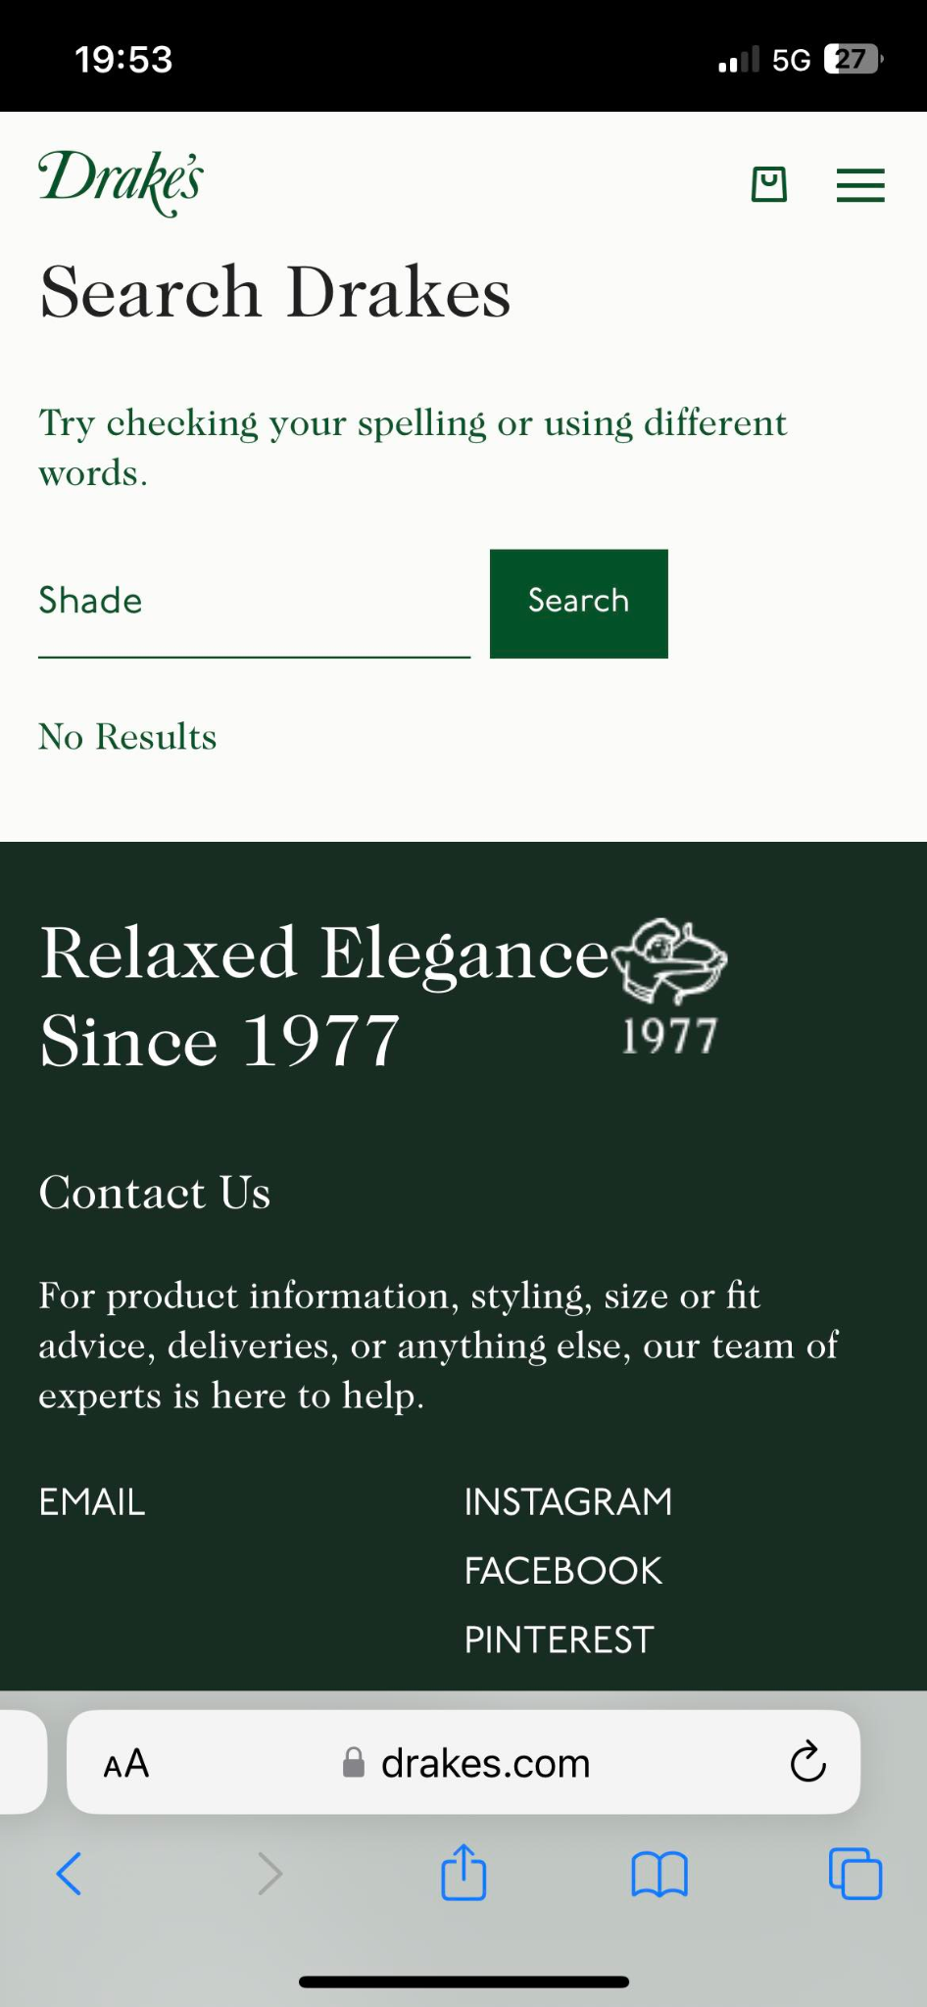
Actionable Improvements
Making sure typos (misspellings) can still drive revenue
A search for “suade” (corrected to shade) on Drakes provides no results despite ‘Suede’ existing within category.
Brought to you by Klevu

Slide 9
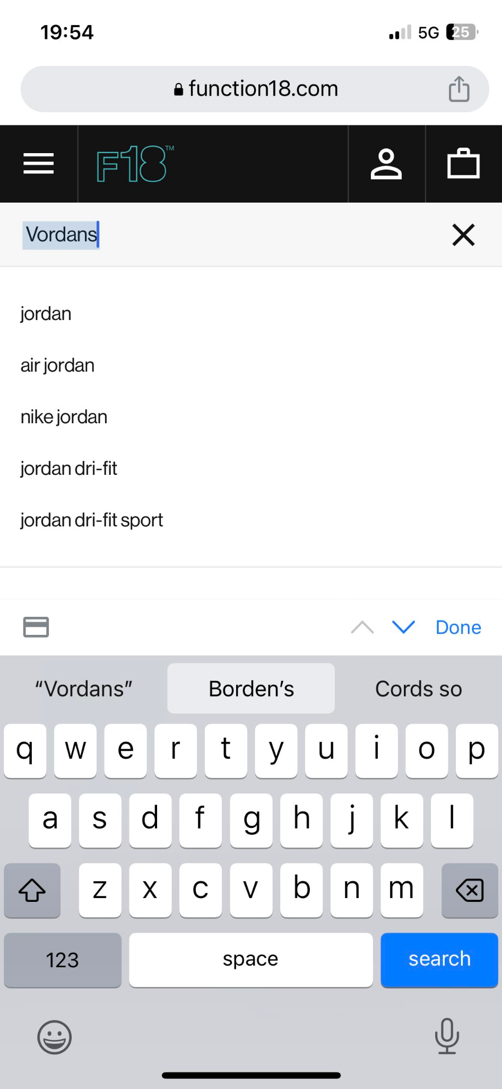
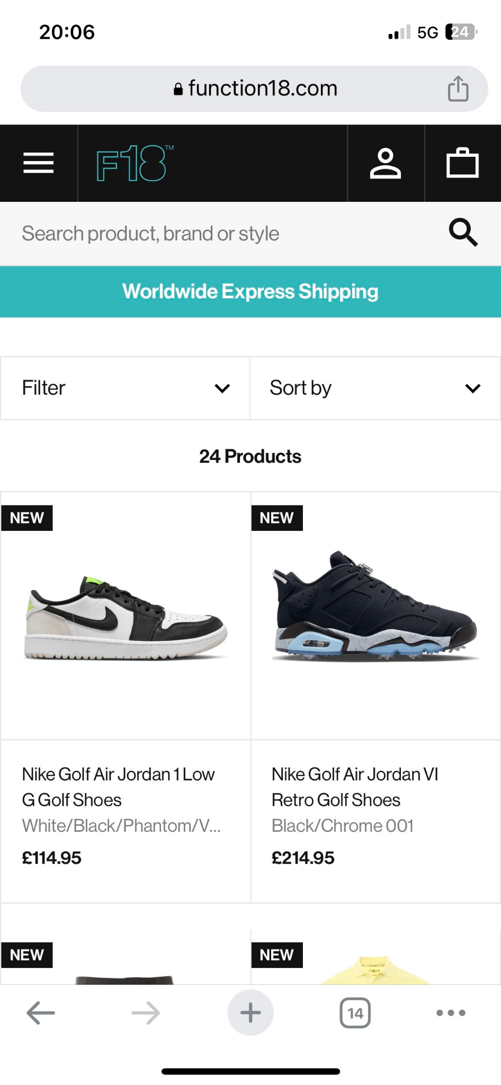
Actionable Improvements
Making sure typos (misspellings) can still drive revenue
A search for “Vordan” or “Vordans’ on Function 18 provides accurate results.
Shoppers will abandon a website if they can’t find what they are looking for, even if they misspelled it! For 56% of retailers, their search experiences are just not surfacing stock they have because of simple typos. Processing natural language, including mistakes, is vital to improving conversion rates.
Brought to you by Klevu

Slide 10
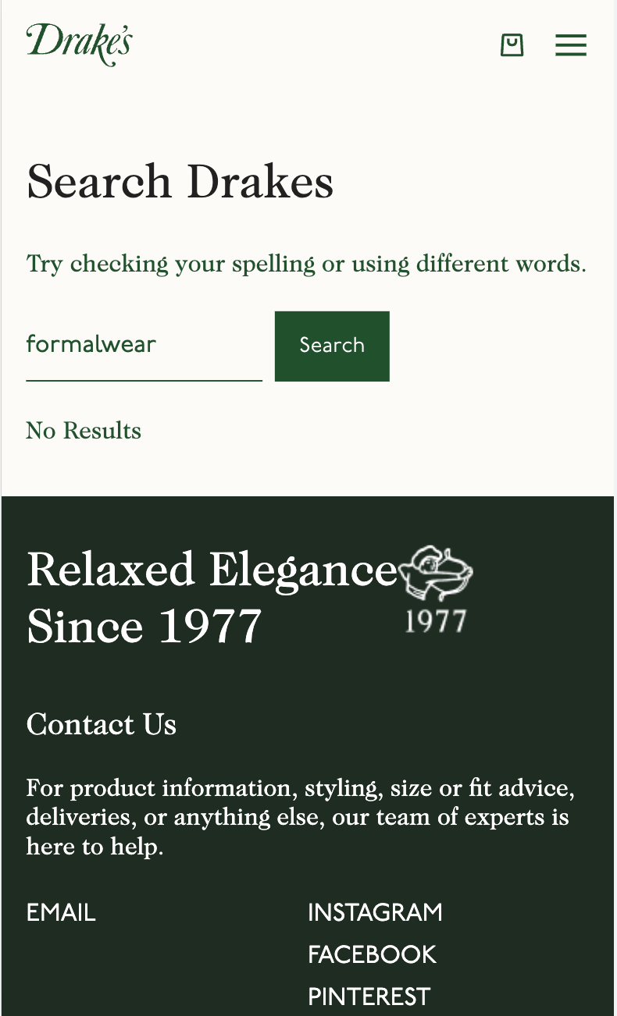
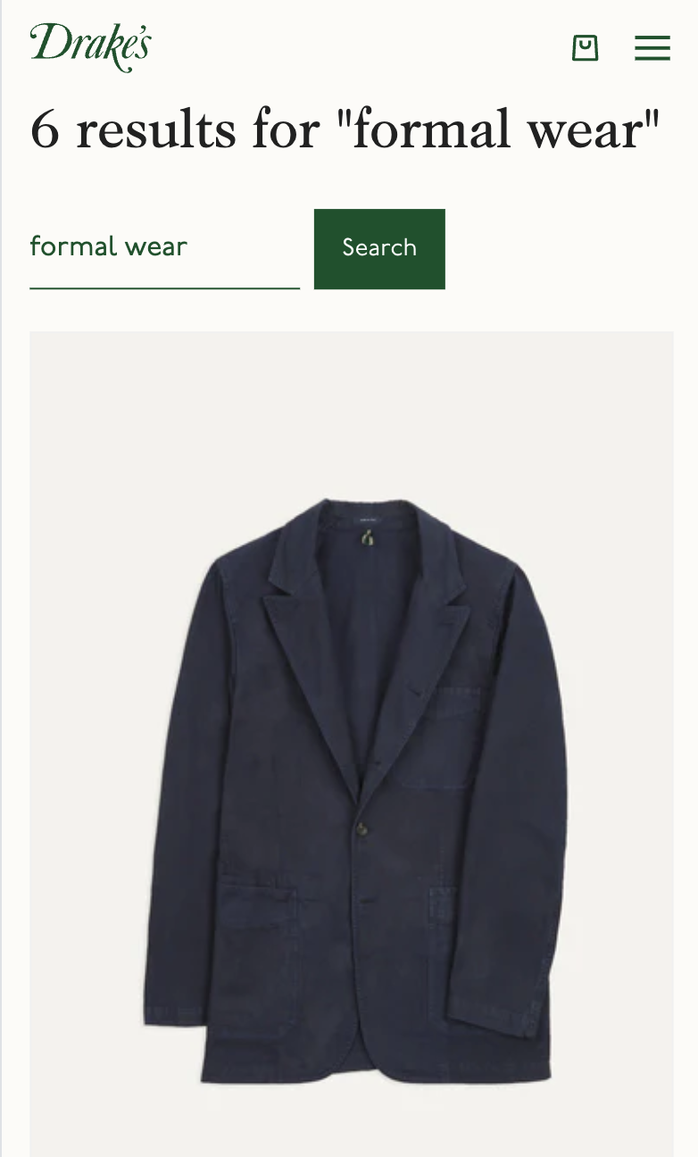
Actionable Improvements
Making sure typos can still drive revenue (decompounding)
A search for “formalwear” on Drakes provides irrelevant results, despite “formal_wear” returning relevant products.
Brought to you by Klevu

Slide 11
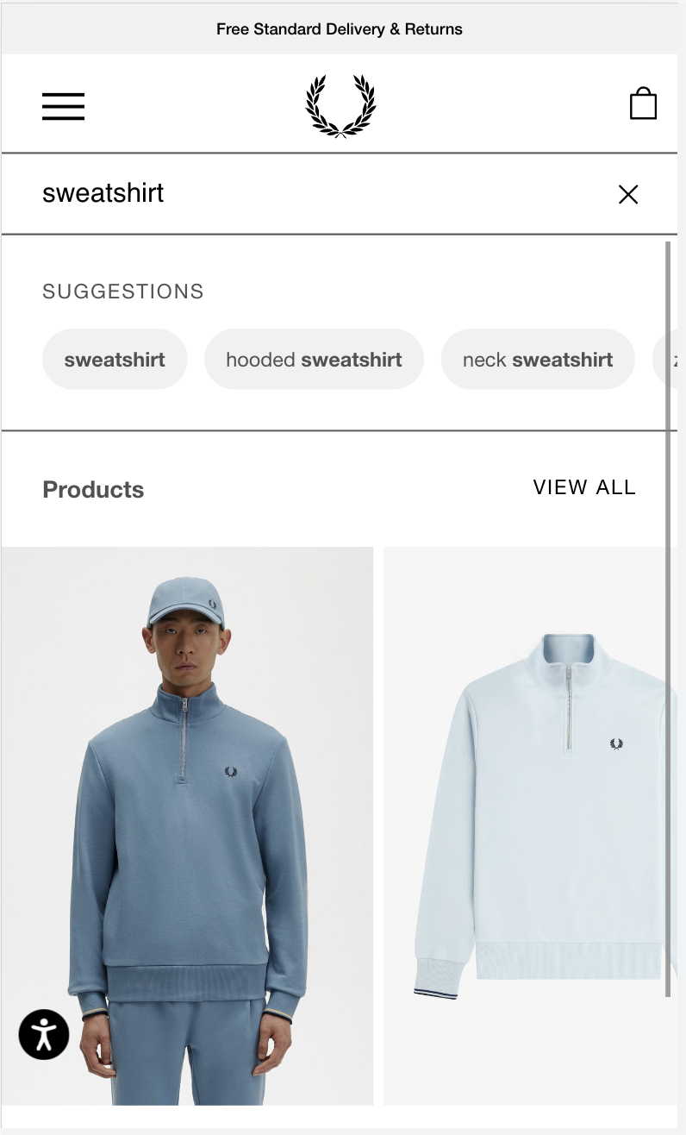
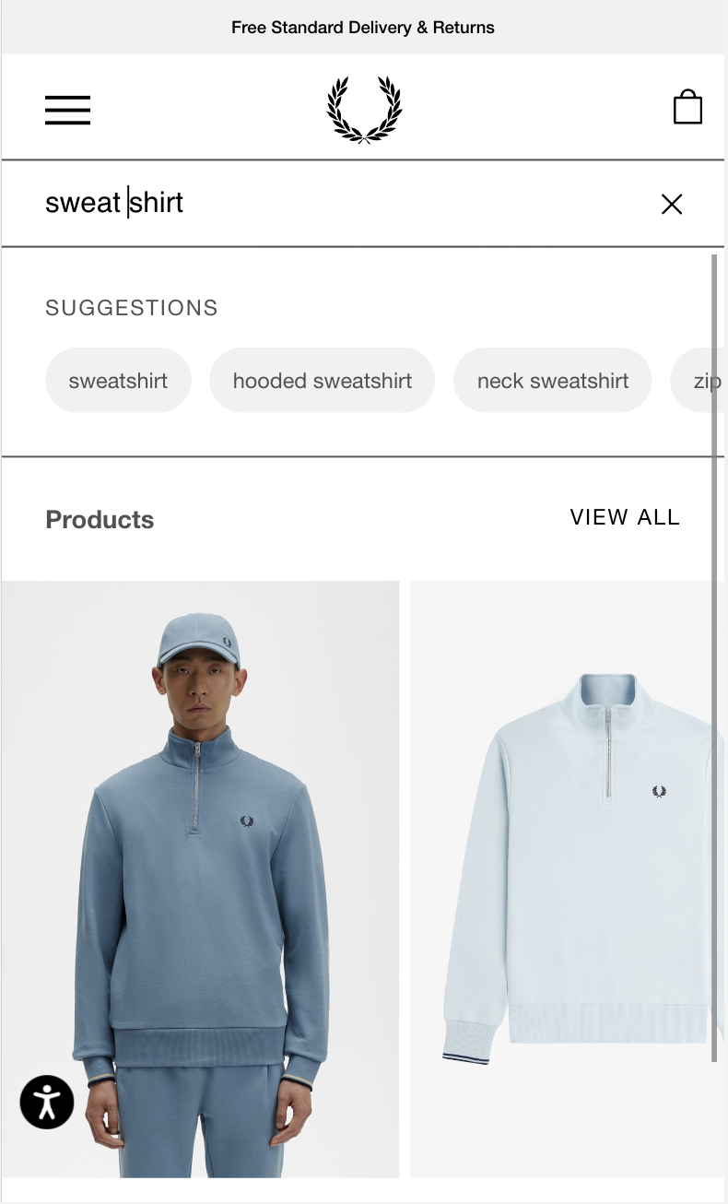
Actionable Improvements
Making sure typos can still drive revenue
A search for “Sweatshirt” or ‘Sweat_shirt’ on Fred Perry provides the same relevant results
Shoppers will abandon a website if they can’t find what they are looking for, even if they misspelled it!
Brought to you by Klevu

Slide 12
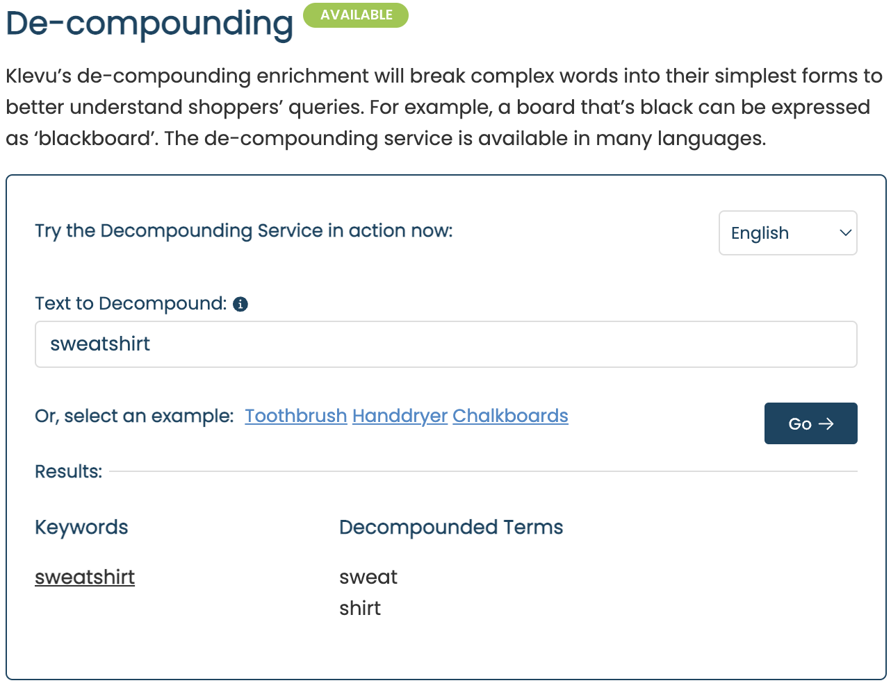

Slide 13
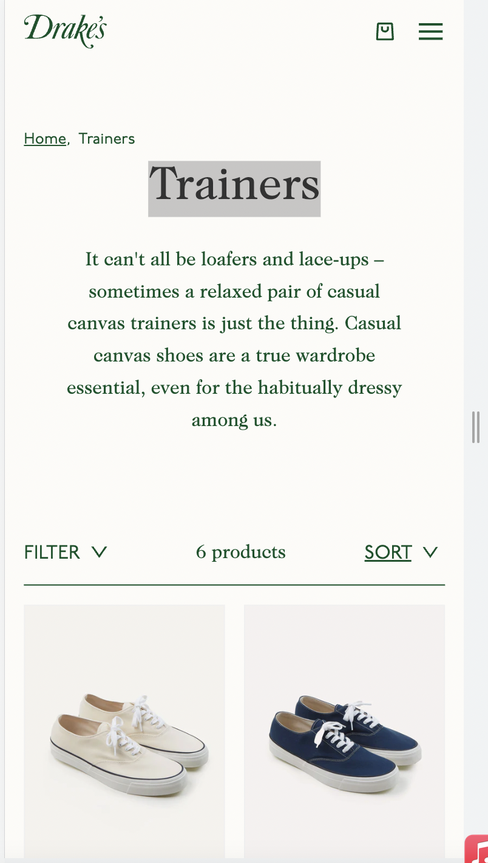
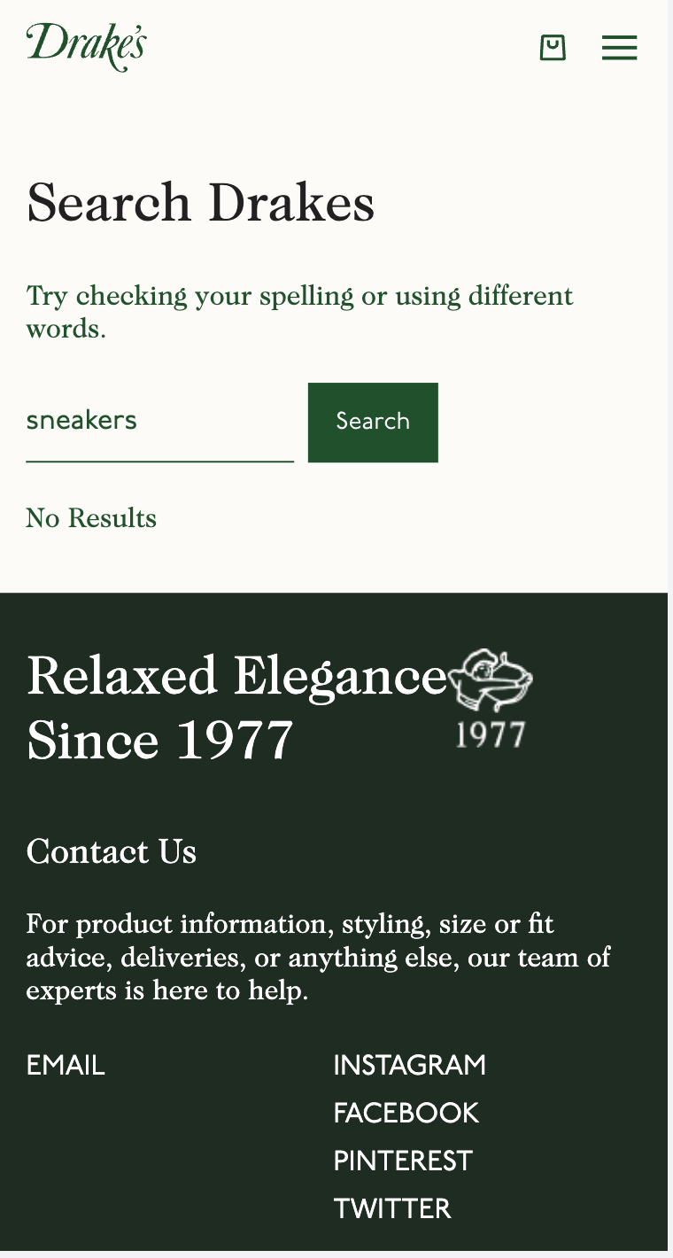
Actionable Improvements
‘Trainers’ category exists
‘Sneakers’ returns 0 products
Brought to you by Klevu

Slide 14
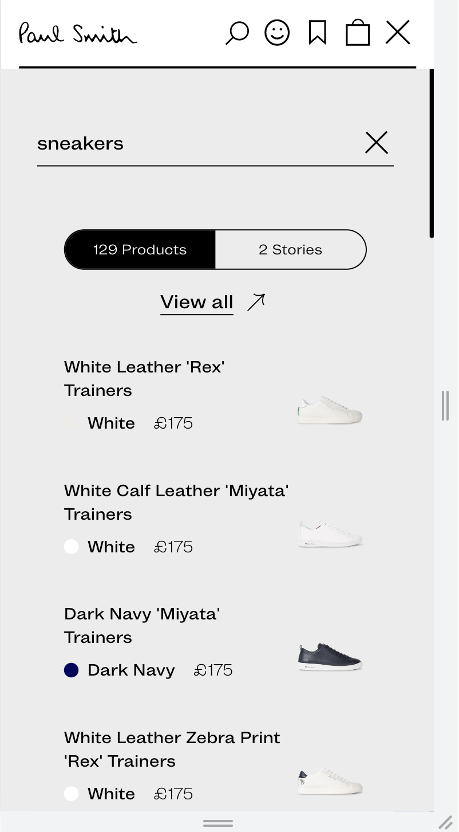
Actionable Improvements
Add natural language processing to search
On Paul Smith, “Sneakers” provides relevant results, despite products being tagged as ‘Trainers’
Synonym Enrichment (Natural Language Processing) helps search engines process what shoppers mean, rather than just what they search for.
Brought to you by Klevu

Slide 15
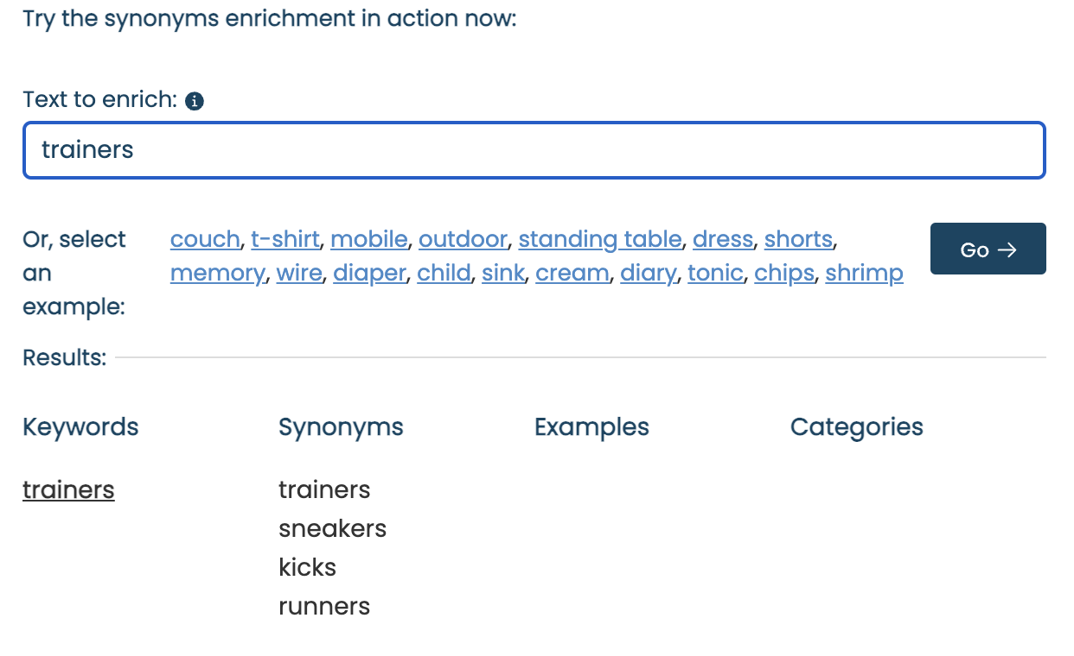

Slide 16
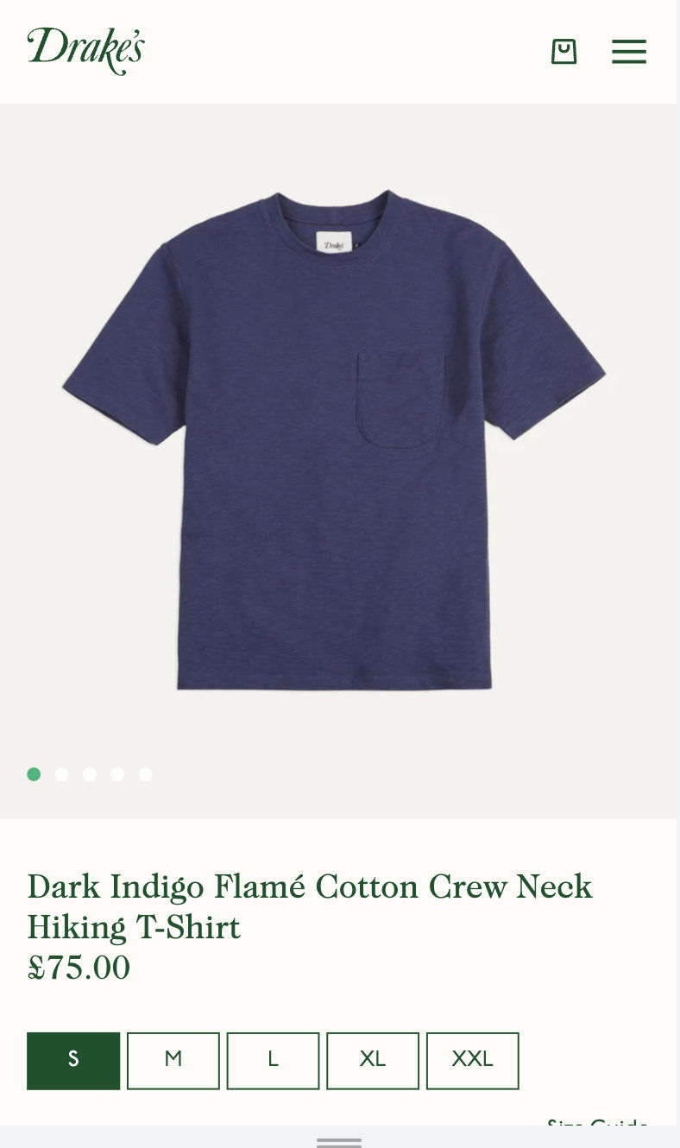
Actionable Improvements
‘Dark Indigo’ T-shirt exits within category
‘Dark Blue T-shirt’ or ‘Blue T-shirt’, search does not return this product on page 1 of search results
Brought to you by Klevu

Slide 17
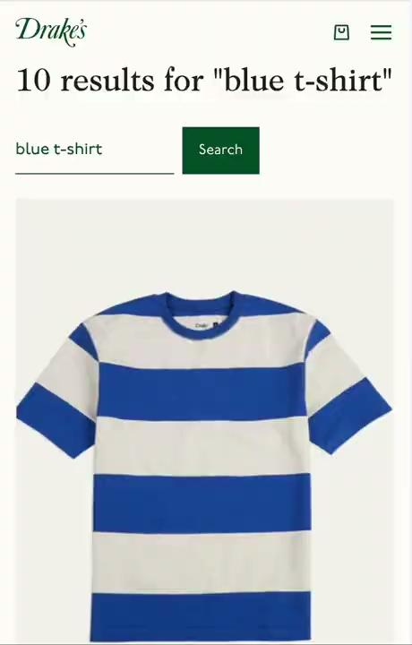

Slide 18
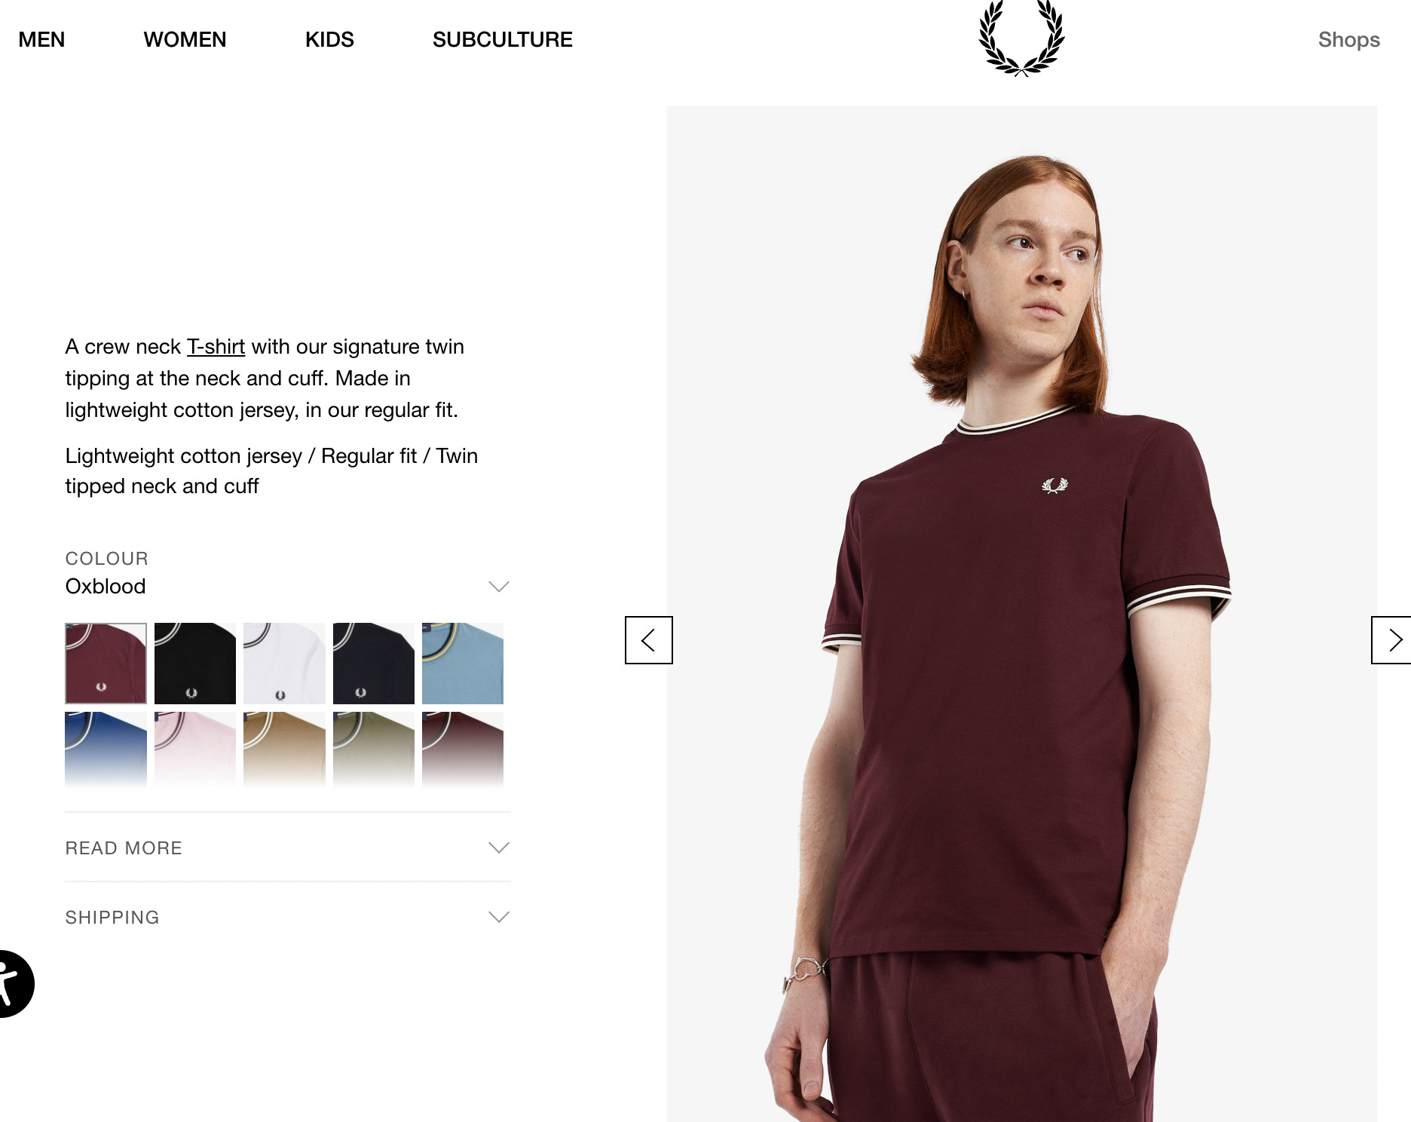
Actionable Improvements
Add natural language processing to search
On Fred Perry “Maroon t-shirt” provides relevant results, despite product colour being tagged as ‘oxblood’
Similar Colours (Natural Language Processing) helps search engines process what shoppers mean, rather than just what they search for.
Brought to you by Klevu

Slide 19
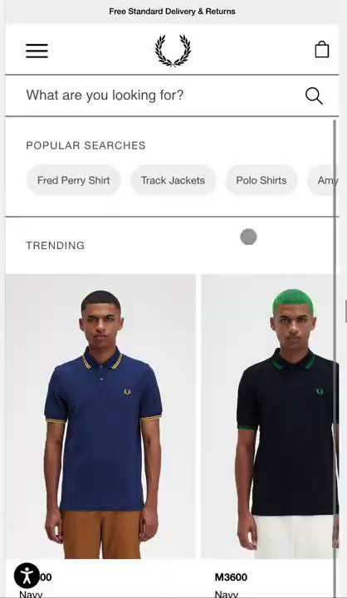

Slide 20
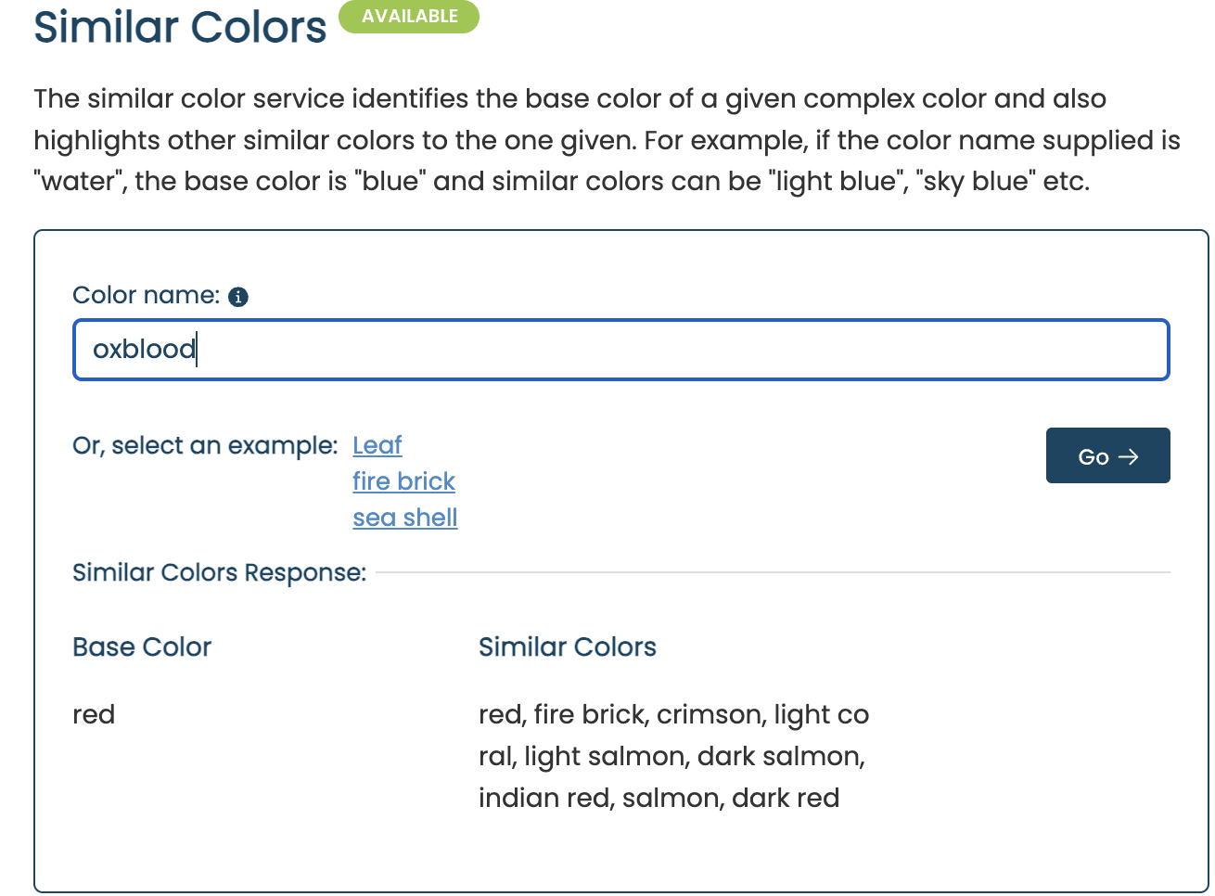

Slide 21
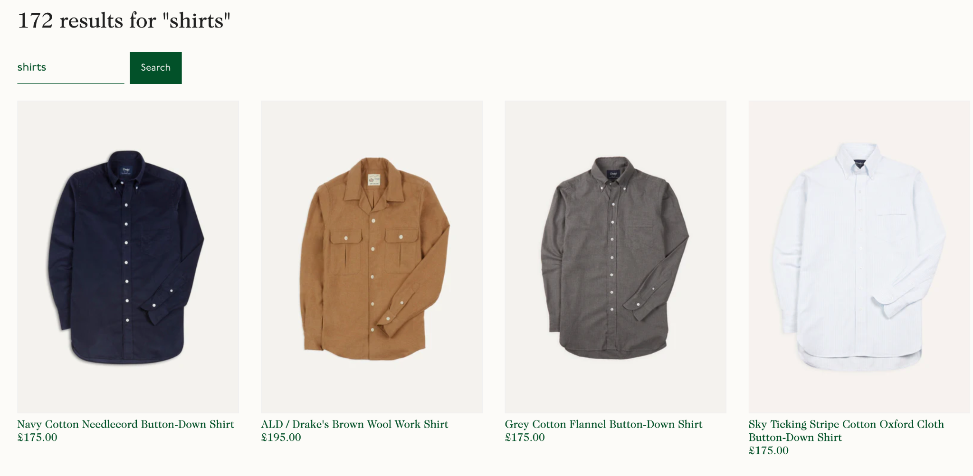
Actionable Improvements
Add comprehensive filtering on Search Result Pages
Drakes does not currently have filtering on the category/search pages
Brought to you by Klevu

Slide 22
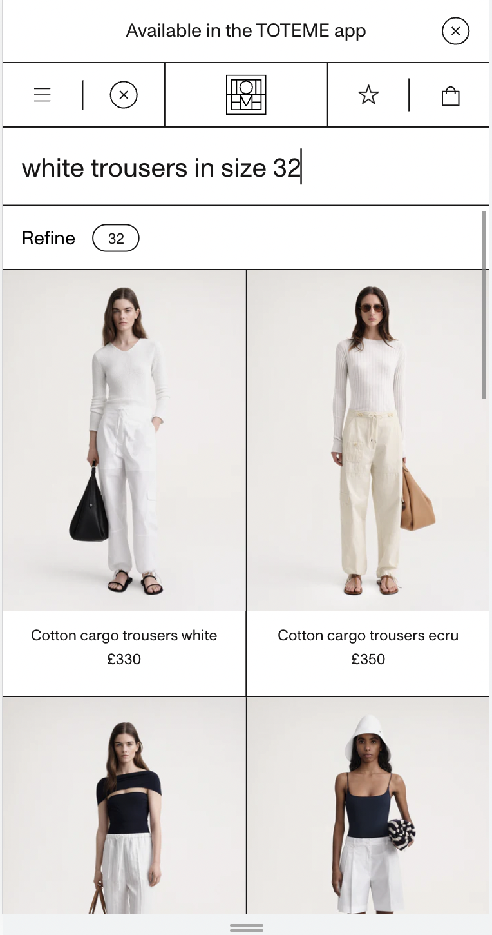
Actionable Improvements
Add comprehensive filtering on Search Result Pages
Toteme has dynamic filtering on the search pages
Adding filters on the search allows shoppers to quickly narrow down their options by selecting relevant attributes such as size, material, or color without leaving the results page. By doing this, conversion rate increases by at least 5%.
Brought to you by Klevu

Slide 23
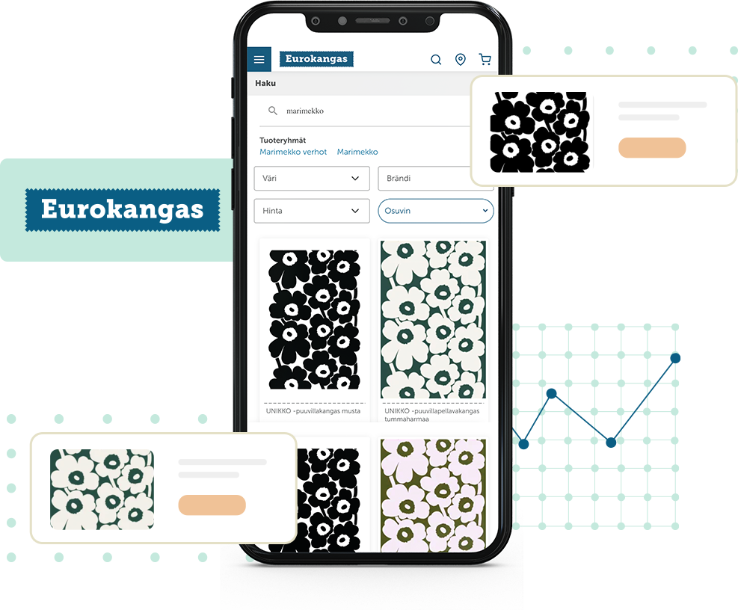
Headless
Eurokangas - Huge spike in mobile conversion
Problem: 60% of traffic comes from mobile devices, search experience needed improvement.
Solution: Built a mobile-friendly headless search with Klevu that persisted the search term
Problem: 60% of traffic comes from mobile devices, search experience needed improvement. Solution: Built a mobile-friendly headless search with Klevu that persisted the search term
20%
2X CTR
2 Weeks
Increase of conversion rate on mobile and tablet devices
Click Through Rate Doubled
To see quantifiable results after integrating with Klevu
www.klevu.com

Slide 24
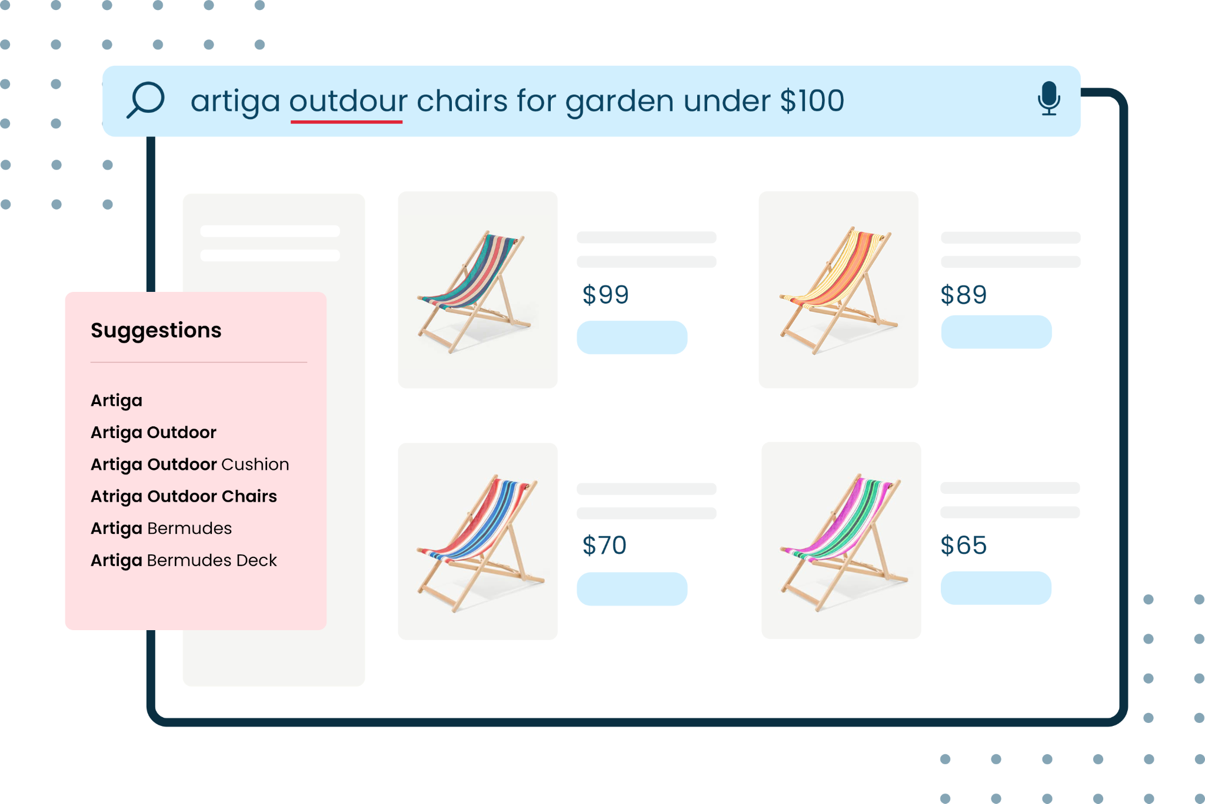
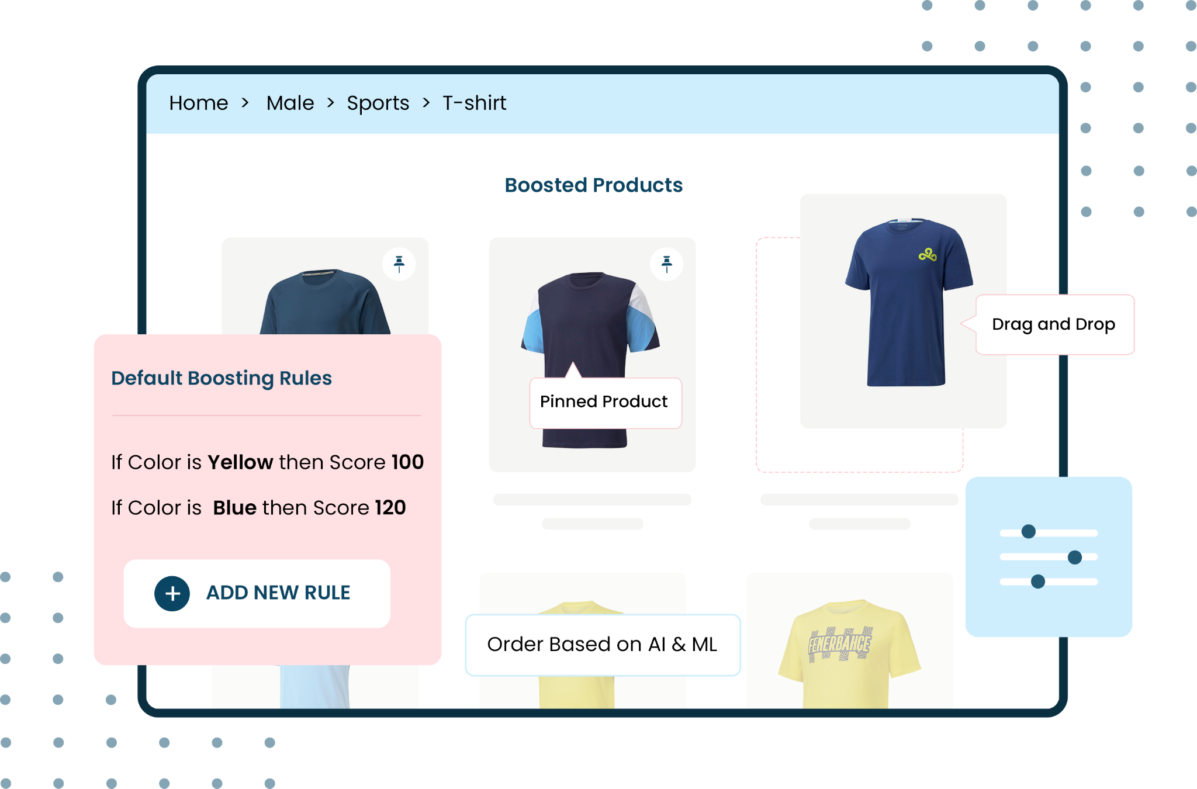
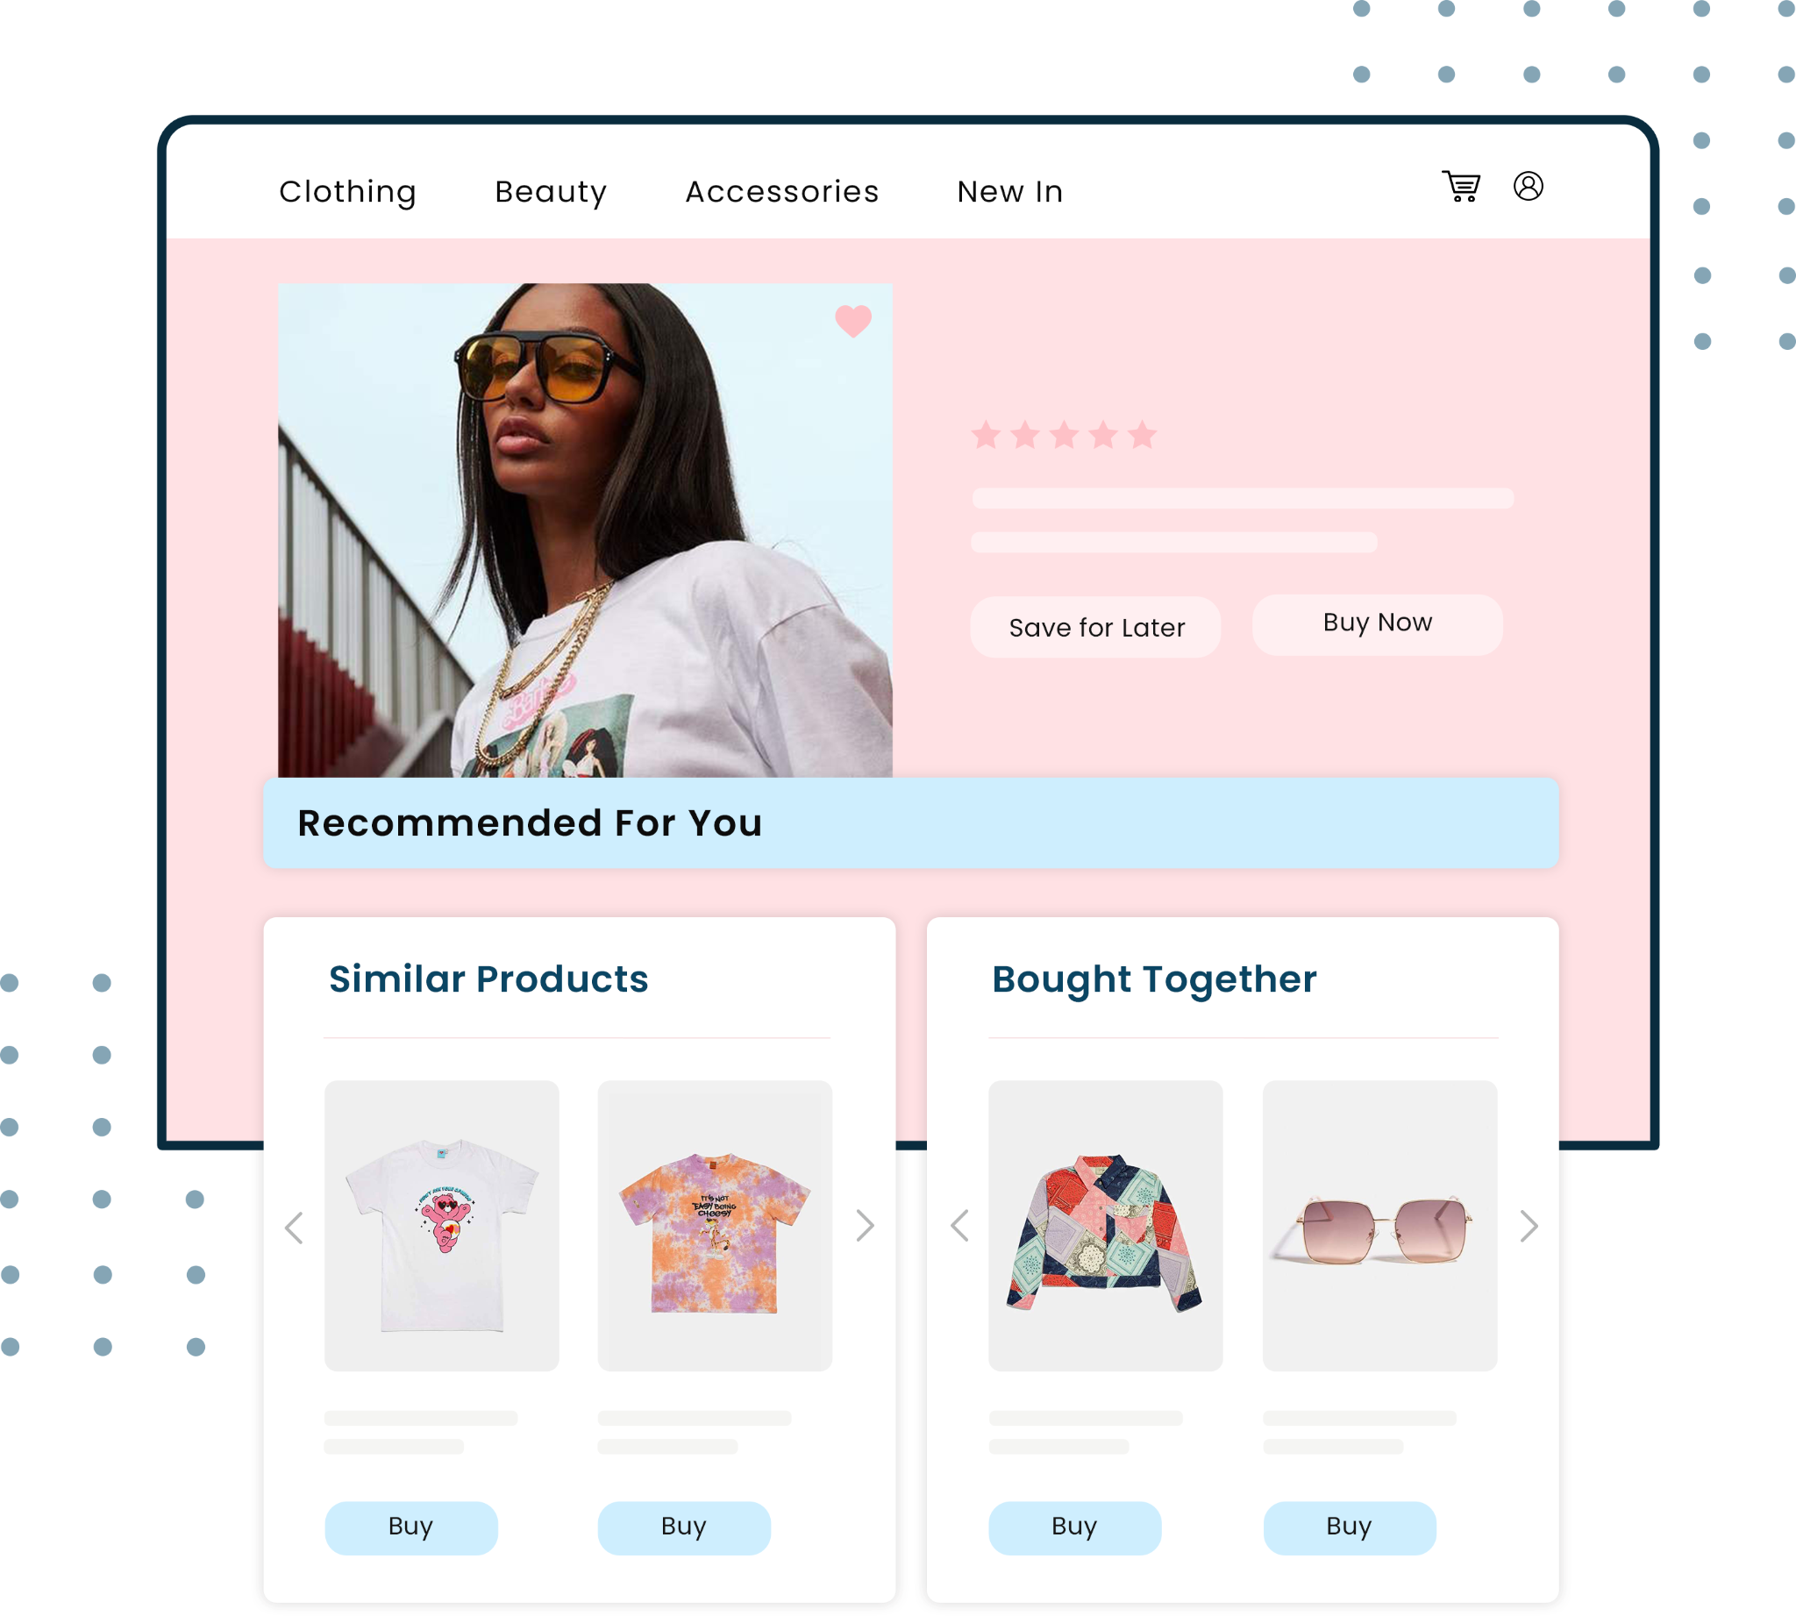
AI-Powered Product Discovery
Klevu
Product Discovery Suite
Smart Search
Smart Category Merchandising
Smart Recommendations
Klevu Smart Search is a powerful and extensible ecommerce search solution that delivers search results based on shopper intentions and behaviour, all in real-time.
Take shopping experiences to the next level with our AI-powered algorithm which automatically optimises the ranking order of products on category pages.
Leverage Klevu machine-learning to power sitewide recommendations, including homepage, collection page, PDP, and checkout page.
www.klevu.com
38

Slide 25
Audit Report
Discover the art of the possible:
Ecommerce Search & Product Discovery Software Buyer’s Guide
Current Klevu Customer Stories
Brought to you by Klevu
WWW.KLEVU.COM

