Slide 1
Growing eCommerce through Mobile Commerce

Slide 2
Josh Guthrie Country Manager - UK
Emilia Swiecicka Partnerships Manager - UK

Slide 3
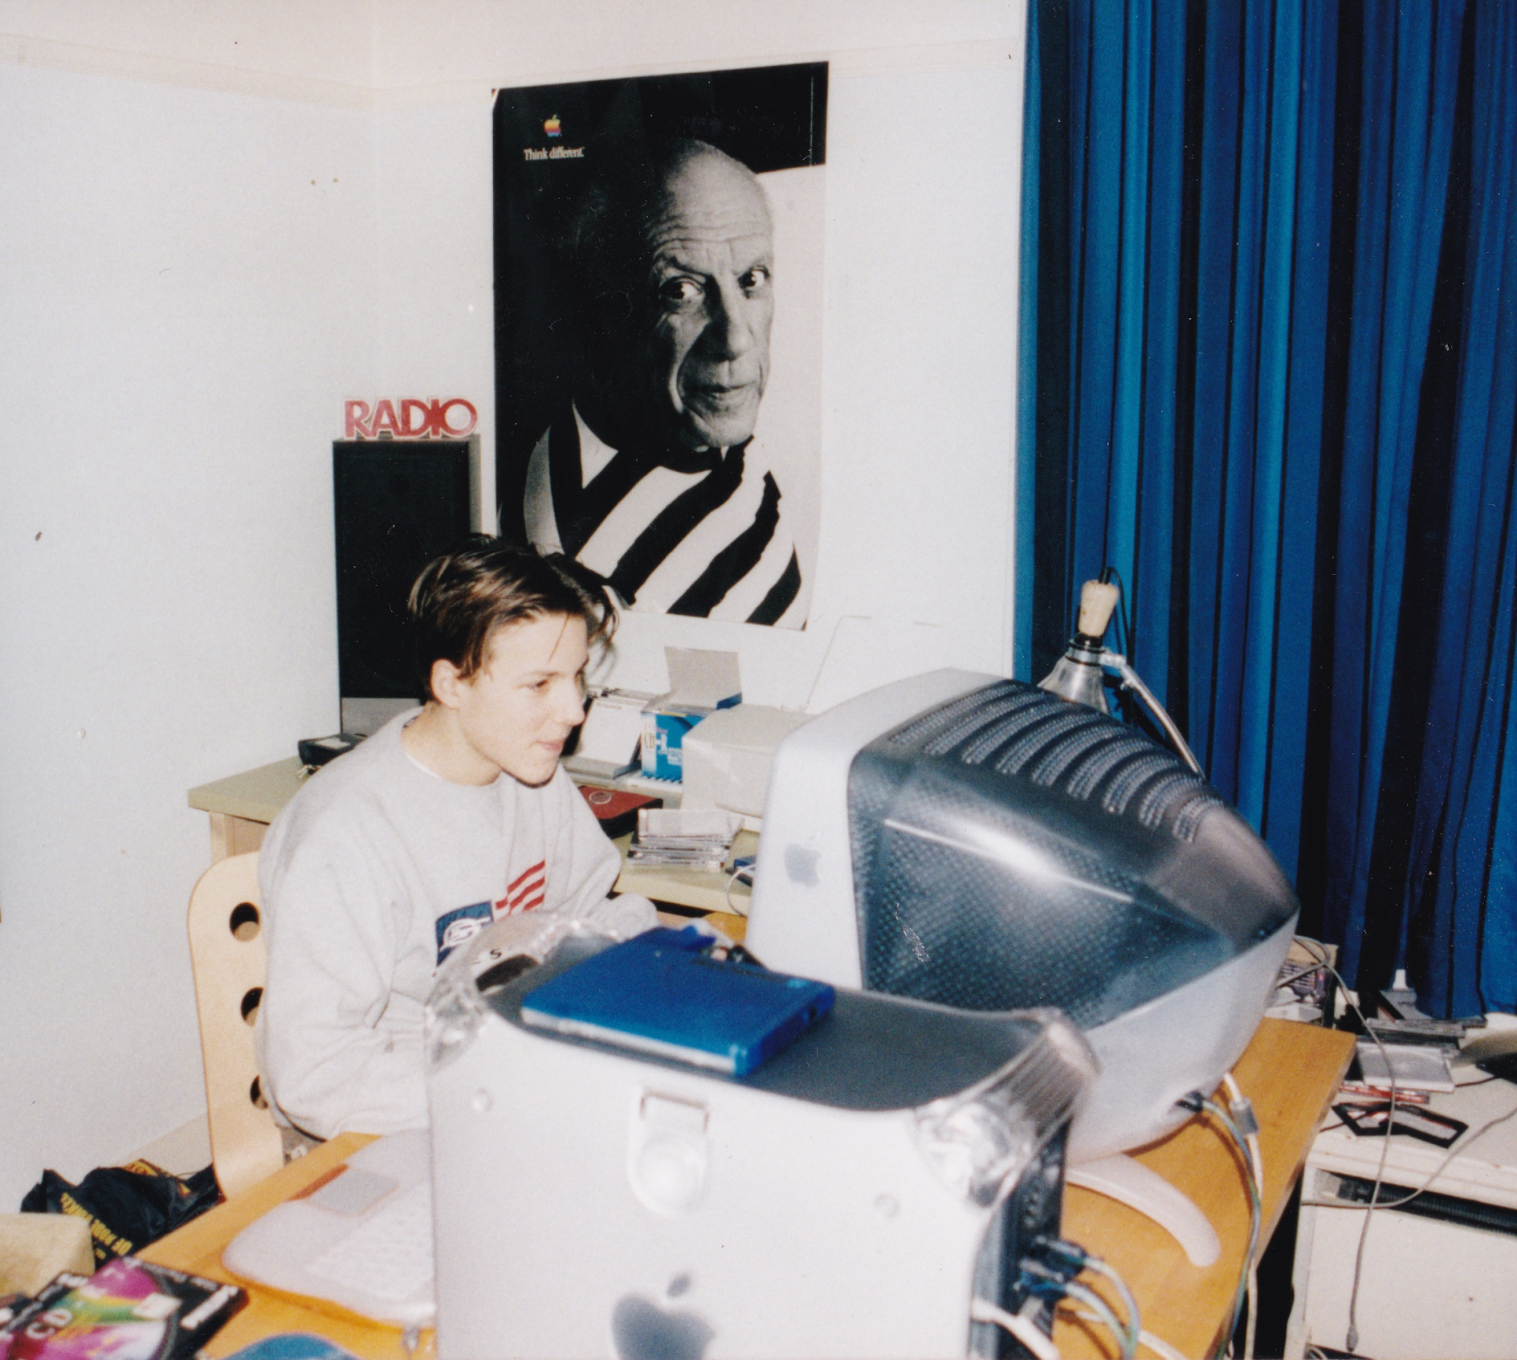
Mollie
‘Payments facilitator’ / PayFac / Gateway / PSP
Bring payment methods together; integrate with ecommerce platforms
European roots, founded 2004 in The Netherlands
250 > 800 in 18 months
Onboarding UK customers for years to process EUR volume; more recently GBP
You’ll find us in King’s Cross

Slide 4
Why it matters
73% Mobile share of eCommerce purchases in 2021
The opportunity
80% Cart abandonment rate on mobile
£20.6B Total abandoned carts in UK in 2022
What it means for you
2023 Not the year to leave money on the table; time to optimise mobile
Notes:
Mobile Commerce represents 69% of the UK eCommerce spend (Statista 2022)
80% cart abandonment rate on mobile (Statista 2022)
73% of purchases on a mobile device https://www.statista.com/statistics/806336/mobile-retail-commerce-share-worldwide/#:~:text=This%20statistic%20gives%20information%20on,from%2058.9%20percent%20in%202017.
62.8 billion uk mobile spend 2022 https://blog.adobe.com/en/publish/2023/01/23/adobe-digital-economy-index-2022-uk-data-retailers#:~:text=Mobile%20was%20the%20most%20dominant,came%20in%20November%20and%20December.

Slide 5
Why more friction on Mobile?
3% Average conversion rate on Mobile
7% Average conversion rate on Desktop
Notes:
Statista shared the mobile conversion rate i

Slide 6
Optimising for mobile in the checkout
Avoid redirects
Add wallets
Simplify steps for the customer - saved card functionality
Present local payment methods when going international
Consider the page speed

Slide 7
Avoid redirects
Stay on the same page! Avoid using a redirect to reduce steps in the checkout
Notes:
Slide per functionality - show all things in imagery https://docs.google.com/presentation/d/12n0ddILKVwXhY-DETYom_JDhYfJJIubIY16LpHQUBuk/edit#slide=id.g146b8f446b6_0_0

Slide 8
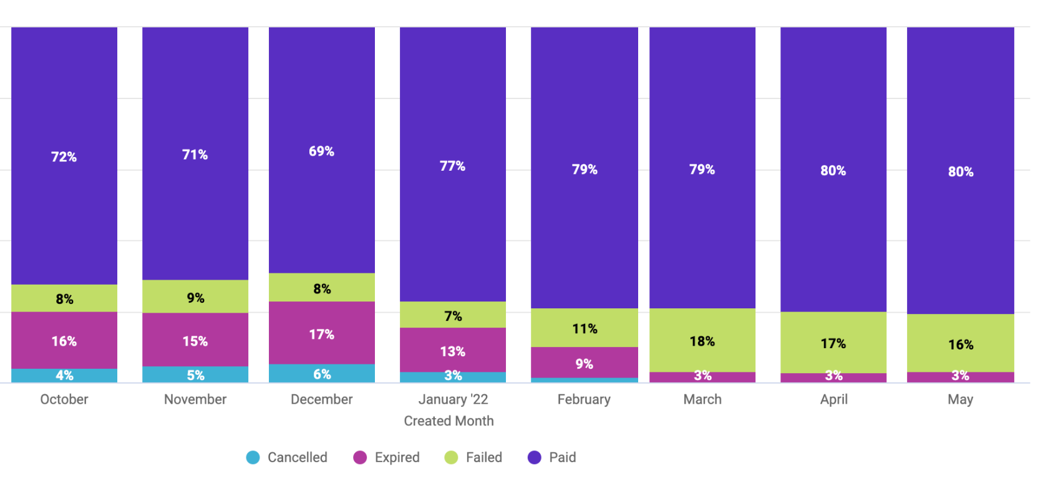
Example of an existing Mollie user: Conversion uplift with Mollie Components (iframe)
This merchant implemented Mollie Components in January, conversion went up from ±70% to ±80% over a 2-month period.
Notes:
Add definitions cancelled, expired, failed payments

Slide 9
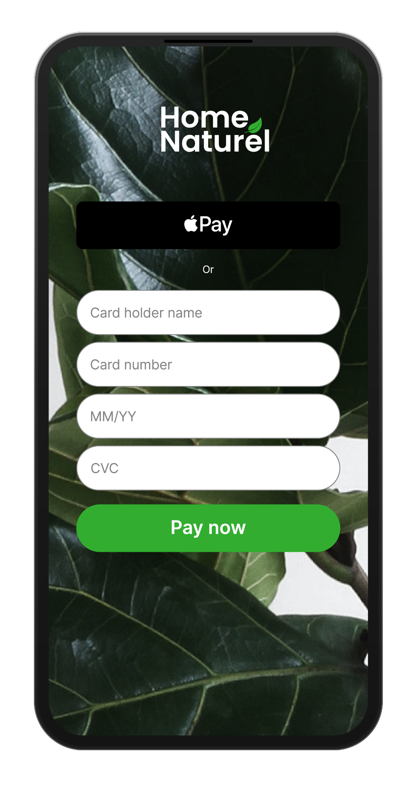
2. Add Wallets
Use your card without the hassle of typing out details
PayPal (a long + shared history with Magento)
Apple Pay represents a significant share in UK ecom today and we see it rapidly take share when enabled
Google Pay and other mobile wallets are growing in use
Notes:
Mention shop pay as a wallet? Would you rather click apple pay or fill in your details?

Slide 10
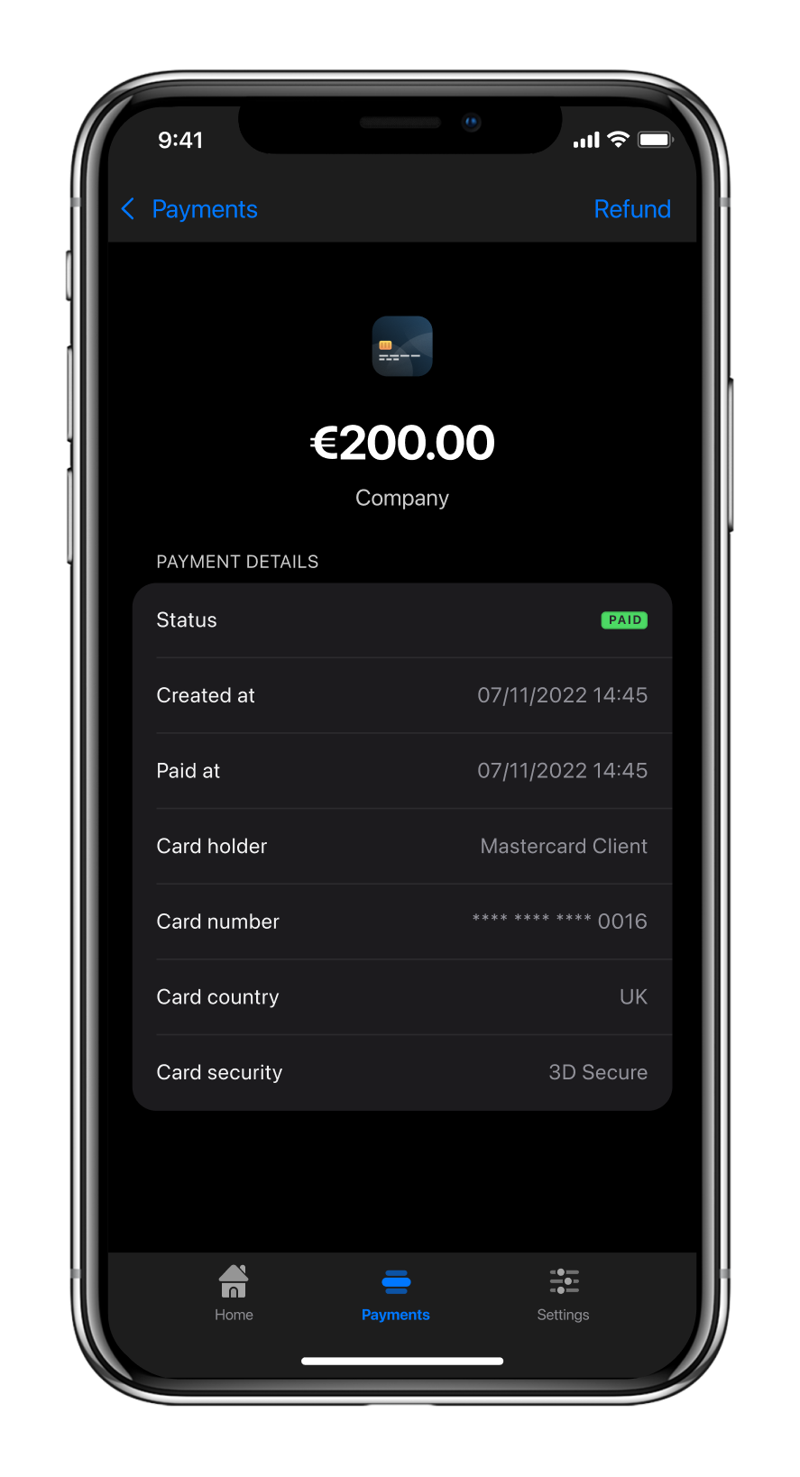
3. Make it easy for
the customer
Enable saved cards - Magento Vault
Consider a payment link or QR code for customers over the phone or in emails
Notes:
Use functionality available to you within your ecommerce platform

Slide 11
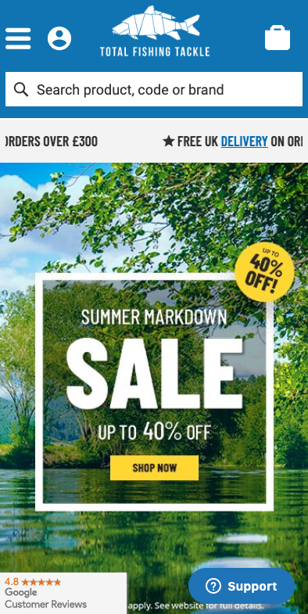
Total Fishing Tackle use Mollie for effortless payments by card, PayPal and Apple Pay on Magento.
From decision to live in 14 days.
Now they get praised on their customer experience
Notes:
Introducing new payment methods - apple pay, no redirect

Slide 12
“You can see the best thing about Mollie by going to our Feefo page, because now every review says ‘great website’, or ‘easy to use’ and ‘great payment’. That’s definitely due to Mollie.”
Total Fishing Tackle

Slide 13
4. Present a localised experience
European payment preferences vary significantly
Get to know the local favourites
Offer them to maximise conversion
Bonus: rates for EU methods can be lower
Notes:
Slide per functionality - show all things in imagery

Slide 14
Facetheory leveraged APMs to enter new markets
Cruelty-free, vegan skincare brand started in the UK in 2015 and looking to grow in Europe.
Built trust with first-time buyers by always offering familiar local payment methods.
Future steps to add local warehousing and hire country managers to deepen understand of EU markets.
Don’t have to wait; launch with the right methods.

Slide 15
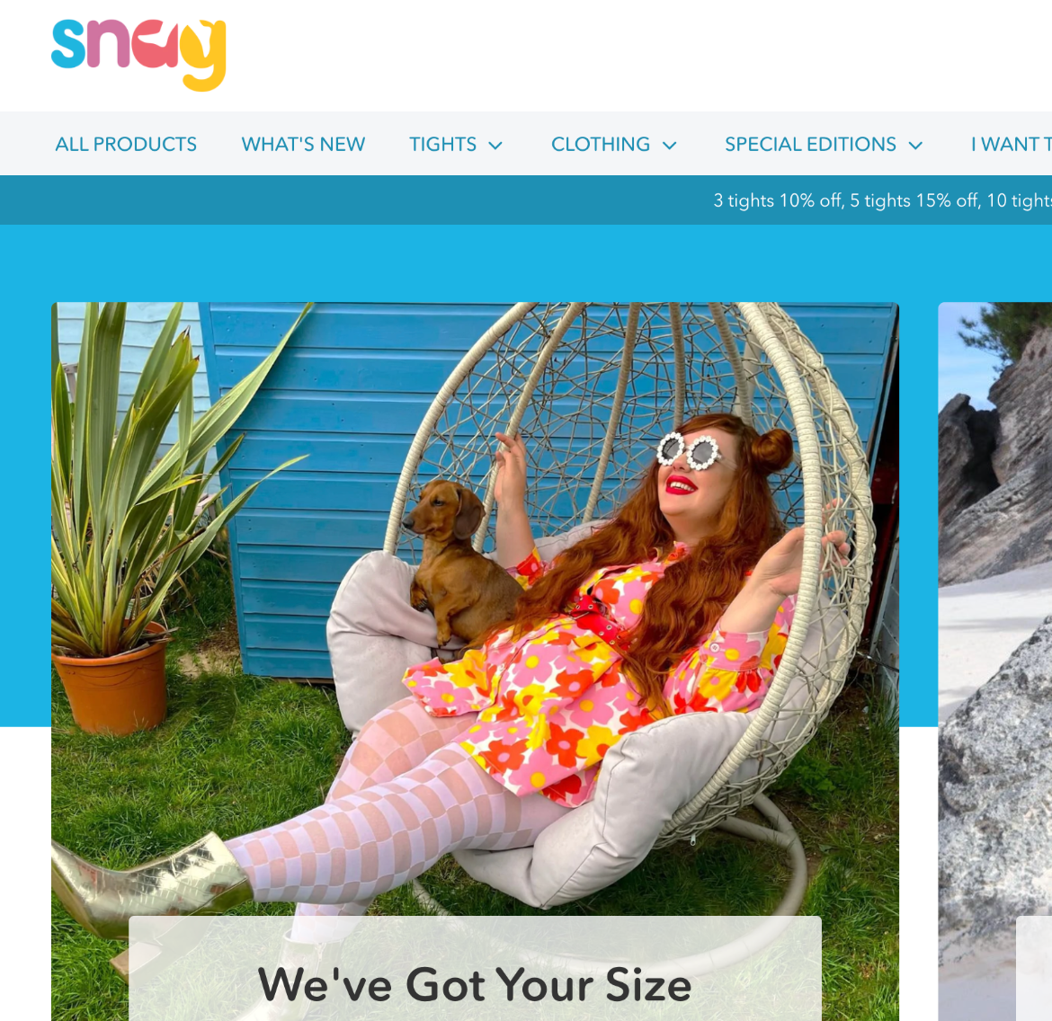
Snag Tights saw a 2% lift in CVR simply by enabling Sofort
Ethical fashion brand providing tights and swimwear for bodies of all sizes (think post-surgery, different shapes and weights, et al).
Big on customer feedback.
Getting some German conversions but lower CVR vs UK. Customer research uncovered EU customers wanted their familiar methods.
Translated website (8%) and enabled Sofort, iDEAL & Bancontact (2%).

Slide 16
5. Is it all speedy enough?
Consider your front end & theme Is a PWA right for your business? Or a front end theme like Hyvä?
One step checkout
Work with your agency to prio page speed - 53% of users will abandon a site if it takes longer than 3 seconds to load!
Notes:
Will leave this to the experts at Screenpages but important to consider what your website runs on and establish whether a PWA or Hyvä might be right for you

Slide 17
Bonus
Optimising mobile for everyone - including the eCommerce team
“Mollie has not only improved our website checkout experience but has given us greater control and visibility of our income streams via the Mollie app and desktop website. “
ImaginFires - Mollie Customer
Notes:
Mollie has not only improved our website checkout experience but has given us greater control and visibility of our income streams via the Mollie app and desktop website. A significant improvement on our previous platform (Braintree) - James Marsland ImaginFires

Slide 18
Josh Guthrie Country Manager - UK
josh.guthrie@mollie.com
Emilia Swiecicka Partnerships Manager - UK
emilia.swiecicka@mollie.com

