Slide 1
Email and Mobile: The perfect pairing for loyalty
CUSTOMER LOYALTY
Notes:
Hi everyone - Thank you for joining me today for this session

Slide 2
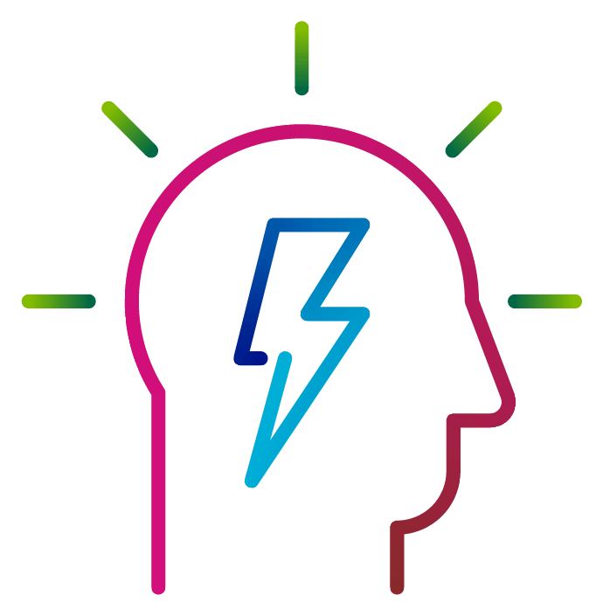
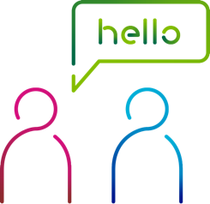
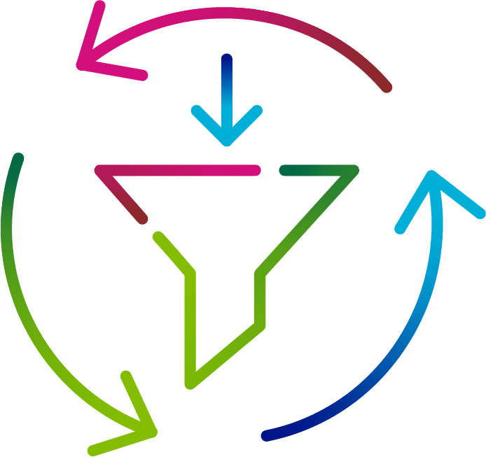
CXDP Platform
4000+ Brands
400+ People
Experience
& Expertise
Notes:
Before I start let’s talk a look at who are Dotdigital and why do we have authority to talk about this?
A best-of-breed CXDP platform that turns data into insight and action.
We have scale. We work with over 4000 Brands and employ over People across the world. We’re a people and platform proposition
And we’ve been growing and evolving for 22 years. So we have a wealth of experience and expertise to help customers achieve their marketing goals.
And about me.
I have been with Dotdigital for over 10 years’ experience - starting as a BDR and now as EMEA Head of Sales.
I have seen the sector grow, develop and change.
I help create solutions that match your needs.
I am passionate in helping brands create meaningful relationships with their customers to drive revenue.

Slide 3
Notes:
But the thing I love telling people about Dotdigital is that In December 2020, we became the first carbon neutral, ISO 14001 certified marketing automation platform in the world.
That means every email, sms, chat response or push notification you send is carbon neutral – pretty cool right?

Slide 4
Brand Challenges in 2023
Increased
competition
Customer acquisition
Customer retention
Consumer behaviour
Notes:
To set the scene – I’m sure none of these will be a shock, but moving into 2023. I’m hearing that brands are facing the following challenges.
Increased competition: There’s a still a huge number of ecommerce brands in the market and many more entering it too this can make it difficult to stand out.
Customer acquisition: Attracting new customers is becoming increasingly expensive, especially through traditional channels.
Customer retention: Retaining existing customers is a constant challenge, as they are faced with numerous options and other brand temptations. 5 x more expensive to aqqui
Consumer behaviour: The constantly changing environment is making it hard for some for brands to keep up.
Do any of these challenges resonate with your challenges?

Slide 5
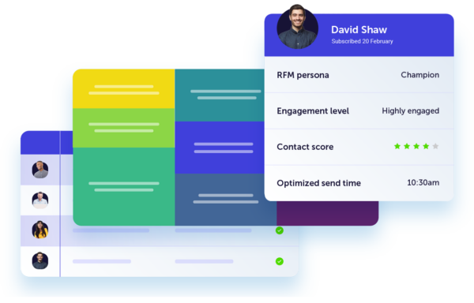
How to overcome these challenges
Customer Data
Notes:
Firstly, we'll dive into the importance of customer data and how it can be used to gain insights into customer behaviour.

Slide 6
How to overcome these challenges
Customer Data
Personalisation
Notes:
Secondly, we'll discuss the power of personalisation and how tailoring your offerings to individual customers can enhance their experience with your brand

Slide 7
How to overcome these challenges
Customer Data
Personalisation
Automation
Notes:
Next, we'll explore automation and how it can streamline your customer service and sales processes, making them more efficient and effective.

Slide 8
How to overcome these challenges
Customer Data
Personalisation
Automation
Multi-channel
Notes:
Lastly, we'll talk about the benefits of multi-channel marketing, which allows businesses to reach customers through a variety of channels such as social media, email, and mobile devices

Slide 9
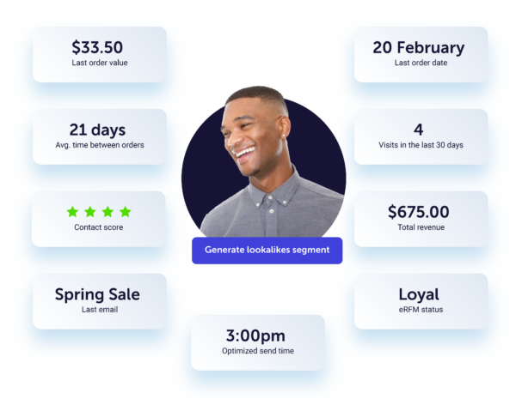
How to overcome these challenges
Customer Data
Personal & demographic data
Onsite behavioural data
Engagement data
Transactional data
Mobile and device data
Personalisation
Automation
Multi-channel
Notes:
Customer Data, put simply, it’s information you receive from customers whenever they interact with your brand.
Customer data’s a cornerstone to a successful marketing strategy, specifically a retention strategy.

Slide 10
Now is the time to utilize your Customer Data
Provides actionable insights
Improves customer experience
Receive valuable information on customer behavior and preferences to increase customer engagement.
Create a better customer experience, which can lead to increased customer satisfaction and loyalty.
Increases efficiency & ROI
Gain a competitive advantage
Enables brands to identify and target the most valuable customers, increasing return on investment.
Get one step ahead of the competition by listening to what works where your rivals brands may not.
Notes:
Why’s customer data key for loyalty and retention marketing?
Provides actionable insights: Customer data provides valuable information on customer behaviour and preferences, which can inform targeted and personalized marketing strategies to increase customer engagement and loyalty.
Without knowing what content, how often, what channel they’d like to receive on, how can we provide engaging content.
Improves customer experience: By understanding customer needs and preferences, brands can create a better customer experience, which can lead to increased customer satisfaction and loyalty.
You can emotionally unsubscribe from a brand if the content doesn’t hit the mark, even if you don’t physically do it
Increases efficiency and ROI: Customer data enables brands to identify and target the most valuable customers, reducing waste and increasing return on investment (ROI)
The Pareto rule, that 80% of revenue comes from 20% of your database. (perhaps not entirely accurate), however highlighting, being more efficient focussing on customers that are most valuable and loyal to you.
Competitive advantage: Effective use of customer data gives you an edge over competitors by enabling more precise targeting and providing deeper insights into customer needs and preferences.

Slide 11
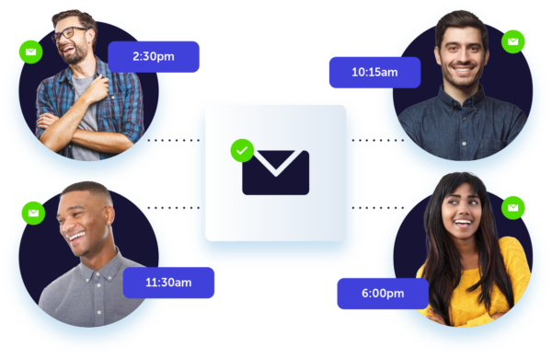
How to overcome these challenges
Customer Data
Personalisation
Personal details
Abandon browse content
Abandon cart content
Personal preferences
RFM
Automation
Multi-channel

Slide 12
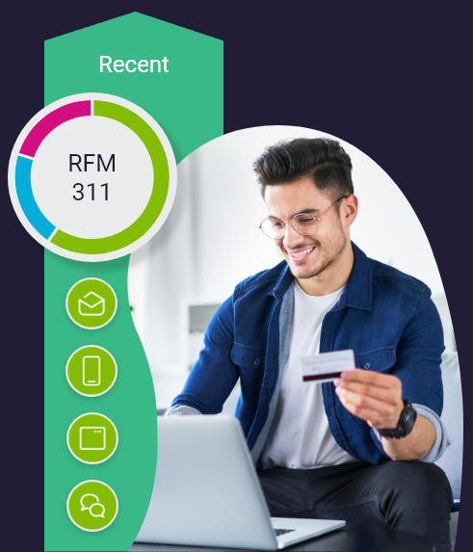
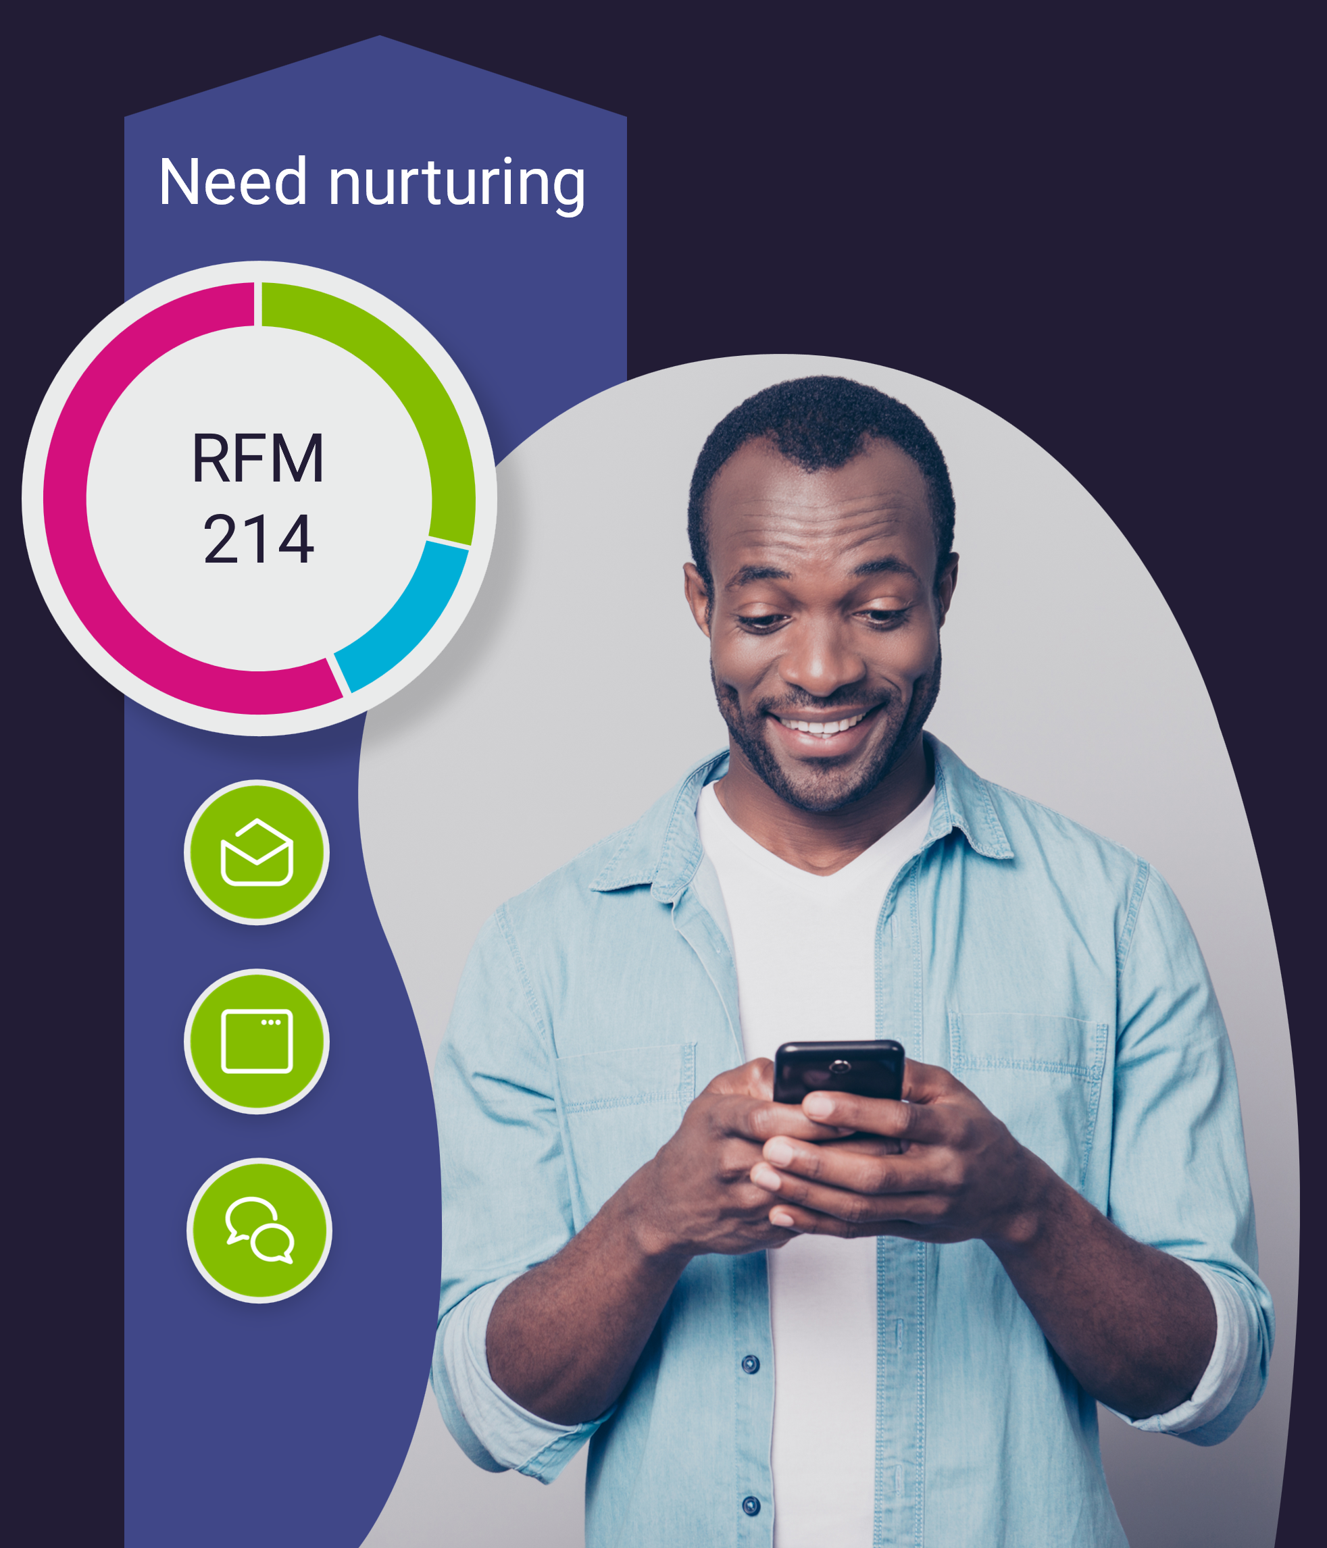
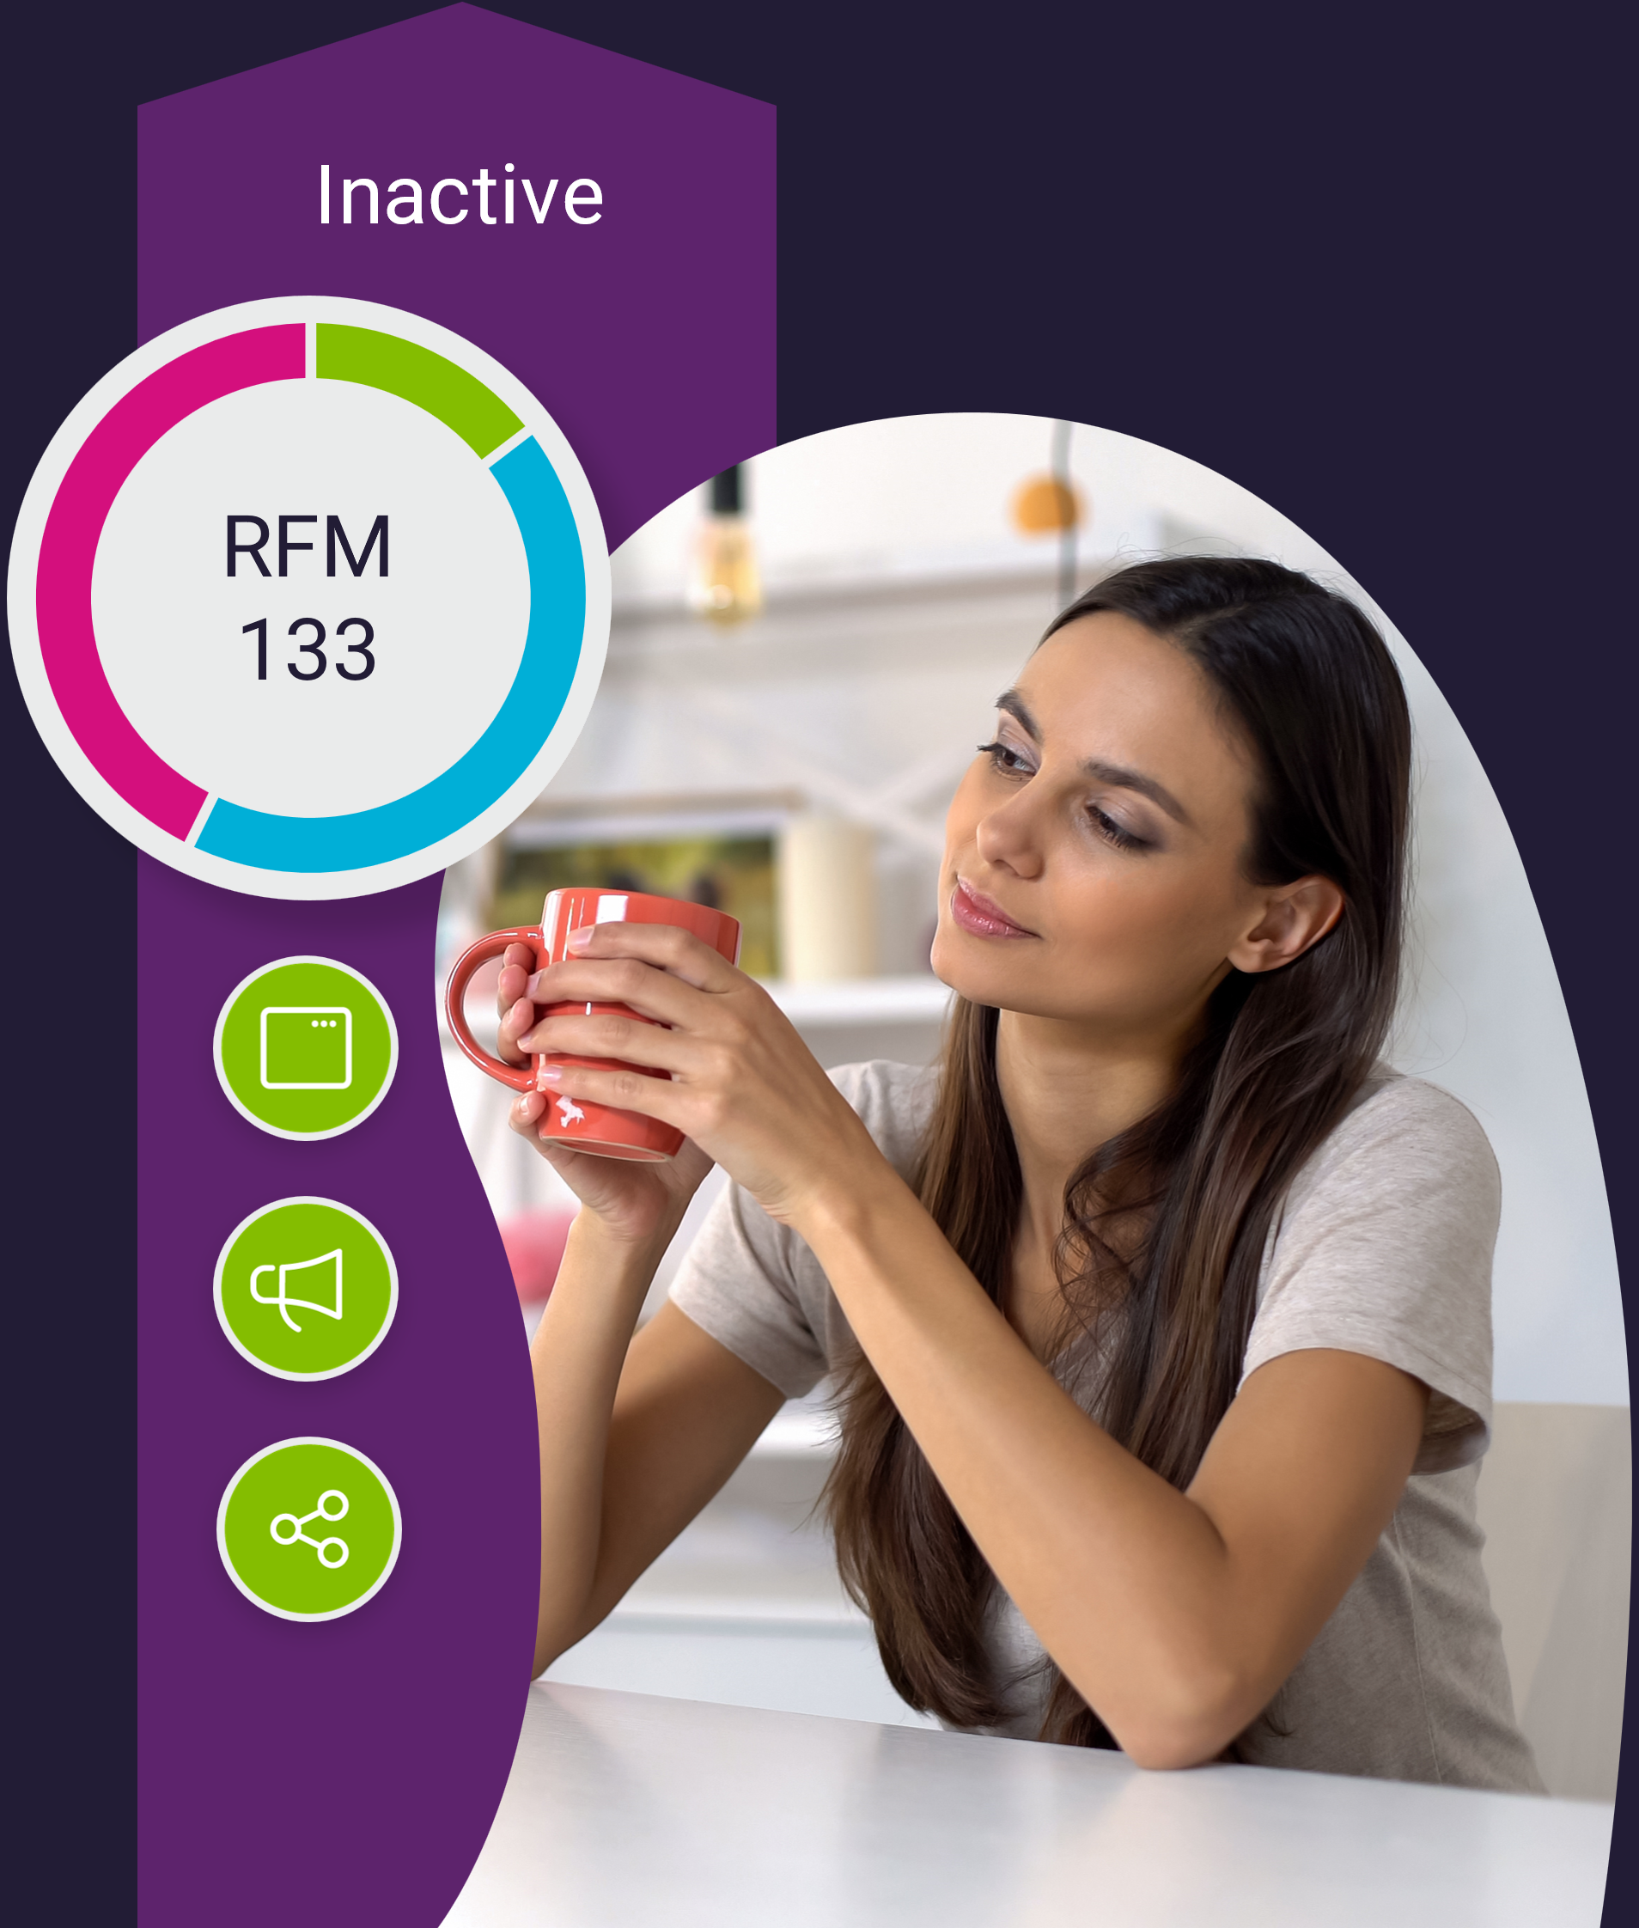
RFM Automatically identifying your levels of engagement
Notes:
Understanding and being able to manipulate customer data easily is the key for smart segmentation.
Using customer engagement platforms, you can very quickly and effectively create segments using the RFM model. Recency, Frequency, Monetary.
This in turn highlights diff personas
Recent buyers, ask for feedback. Up sell? Turn Guest to Customer account , VIP Program?
Needs nurturing – incentivise back with an offer of sorts? Tell more about the brand / values
Inactive – Are their preferences up to date? Reach out to check and reengage, if not are they really valuable?

Slide 13
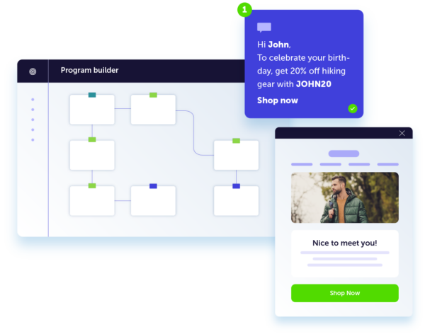
How to overcome these challenges
Customer Data
Personalisation
Automation
Customer Segmentation
Automated follow-ups
Loyalty Programs
Consistency
Interaction led
Multi-channel
Notes:
Mastering automation leads to some great use cases..
Customer Segmentation: Segment your customers into groups based on their behaviour, interests, and preferences. This allows you to create targeted campaigns that are specific to each group, ensuring that your messages are relevant and engaging.
Automated Follow-Ups: Use automation to follow up with customers after they've made a purchase or engaged with your brand in some other way.
This helps keep your brand top-of-mind and ensures that customers receive the right message at the right time. Production recommendations for example….
Loyalty Programs: Use marketing automation to manage and track loyalty programs, such as reward points, discounts, and special promotions. This incentivizes customers to engage with your brand and rewards them for their loyalty, helping to build stronger relationships and retain customers over time.
Consistency: Automate repetitive tasks and ensure that all customer communications are consistent and on-brand. This creates a seamless customer experience that builds trust and reliability, making it more likely for customers to return to your brand in the future.

Slide 14
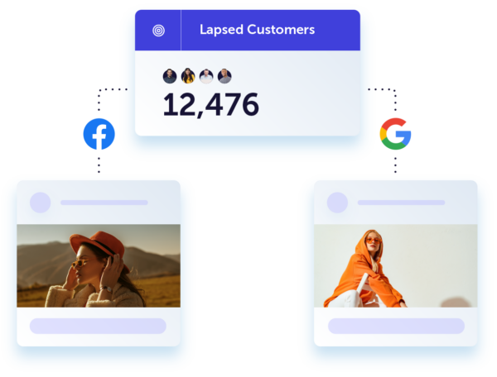
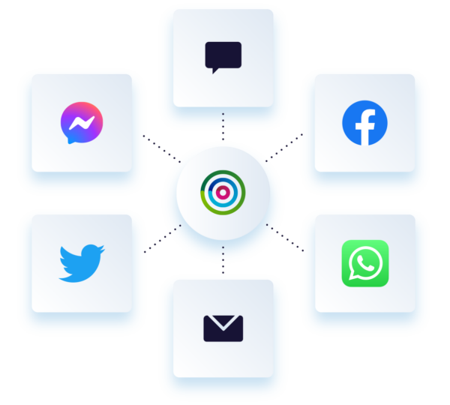
How to overcome these challenges
Customer Data
Personalisation
Automation
Multi-channel
Email
Website and Surveys
SMS and App Push
WhatsApp
Social Media
Notes:
Using a combination of channels helps strengthen your reach of customers and ability to engage with them, creating a more impactful and personalized marketing experience. This, in turn, leads to increased customer engagement and conversions, as well as a stronger relationship between the business and its customers – and you guessed it – loyalty.
But many brands still haven’t embraced a multi-channel marketing strategy.
Last year we published our report Hitting the Mark which analyzed 100 ecommerce brands globally.
Only 18 of the 100 brands we researched were using multi-channel tactics. SMS adoption was low at just 11…. Which is crazy as SMS Stats)
Cust spend on average 3.5 times more with brand when they are engaged on multiple channels
Branch out on different channels
Think of data/ RFM modelling – what qualifies a VIP Cust? Could they proceed to a VIP program. That could include exclusive updates via SMS, Facebook messenger and exclusive emails only they will have access too.

Slide 15
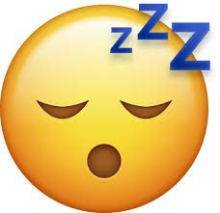
Email marketing and in-app marketing
Reinforce the marketing message
Cross-promoting the app itself
Re-engaging inactive customers
Notes:
App push notifications are thus a great way to make sure that your app, and all the cool products/content within it, is front and center. Push notifications are ‘pushed’ to consumers’ mobile home screen regardless of whether they are using the app at the time. Here are some specific use cases to demonstrate how email marketing and in-app marketing can work together effectively:
Cross-promoting the app: A business can use email marketing to promote their app to customers and encourage them to download it. This can be especially effective for businesses that have a physical location, as customers can be reminded of the app when they receive emails from the business.
Reinforce the marketing message – whether that is – if you’re trying upselling or cross-selling: A business can use in-app marketing to upsell or cross-sell to customers who have made a purchase within the app. For example, the business can deliver a personalized in-app message that promotes complementary products or services to customers who have recently purchased a product within the app.
Re-engaging inactive customers: A business can use email marketing to reach out to inactive customers and encourage them to re-engage with the app. Push is powerful as an engagement or sales tool within it’s own right too. You can use email to announce an ‘App Exclusive’ promotion, which can then be applied ‘on tap’ when the notification is pushed to their mobile home screen.
Plus Delivering timely and relevant information: A business can use in-app marketing to deliver timely and relevant information to customers. For example, the business can use push notifications within the app to deliver information about new products, sales, or events.
By combining email marketing with in-app marketing, businesses can create a multi-channel approach to reach customers and engage with them, providing a more comprehensive marketing experience.

Slide 16
In-app messaging
With the Dotdigital platform
Deep-linking
What happens ‘on tap’
Dynamic audience view
Brand consistency
Order confirmation notifications
Notes:
Dotdigital has some pretty neat features for push nonfictions within apps
Deep-linking. When a customer taps on your push notification, you can direct them to a specific page within your app, this could be to align with your campaign and take them to a particular product category page, or to find out more information about your newly launched member offer.
You decide what happens ‘on tap’. Opening a deep link aside, you can also simply direct the push to open your app on tap, or pass custom JSON data to perform a custom action that your app supports, for example the activation of an offer that is exclusive to your app.
We automatically remove contacts from your push audience if a push notification failed to send to them in the event they have opted out from this channel, meaning you always have a true view of the audience you’re able to reach via this channel.
Adobe Commerce (Magento) integration users can also use Dotdigital push notifications to send order confirmations to their contacts.
Dotdigital also gives you insights into your push notification usage. Track how many pushes were sent, and how many were ‘tapped’ over time. You can filter the report by data range as well as by program you want to display performance data for.

Slide 17
Real-world examples

Slide 18
Personalisation in Welcome emails
Welcome emails are 86% more effective than standard emails
First impressions count
Be sure to use personalisation
Introduce the brand and community
Offers are great here
Have a strong CTA
Notes:
Let’s look at some examples of welcome emails with some personalization,
The first is from Free now – A nice clean and simple email with a first name in the H1. The clear call to action on this email is to book the next trip.
Veja – a little more subtle, however, they also introduce their community by means of welcoming to the family. It’s very in keeping with the brand.

Slide 19
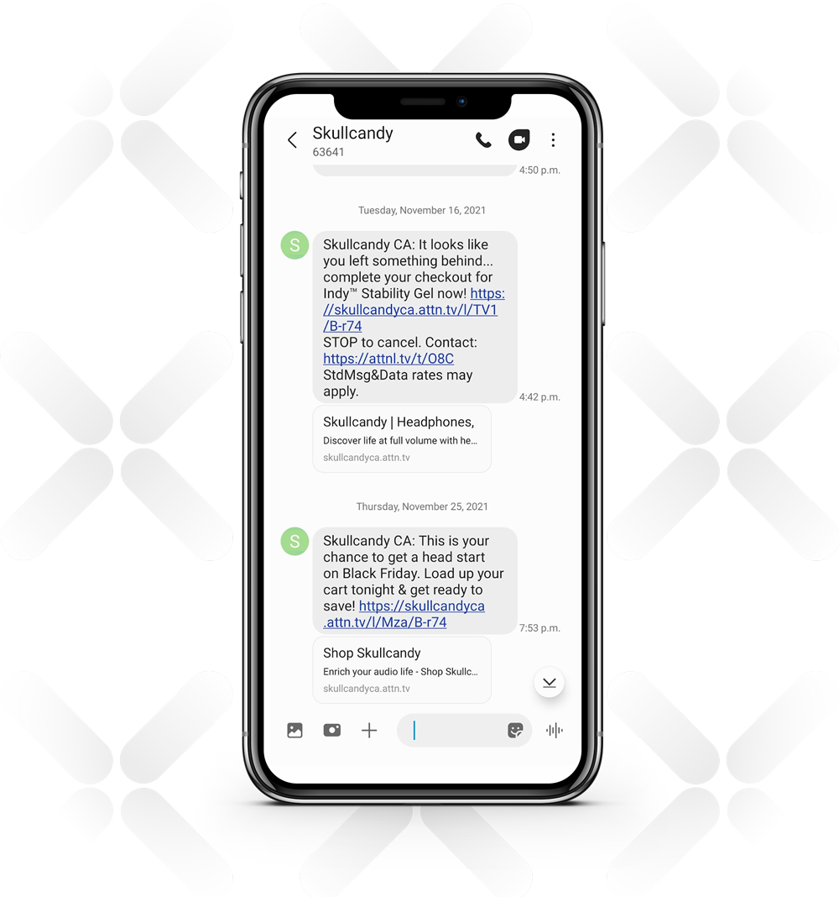
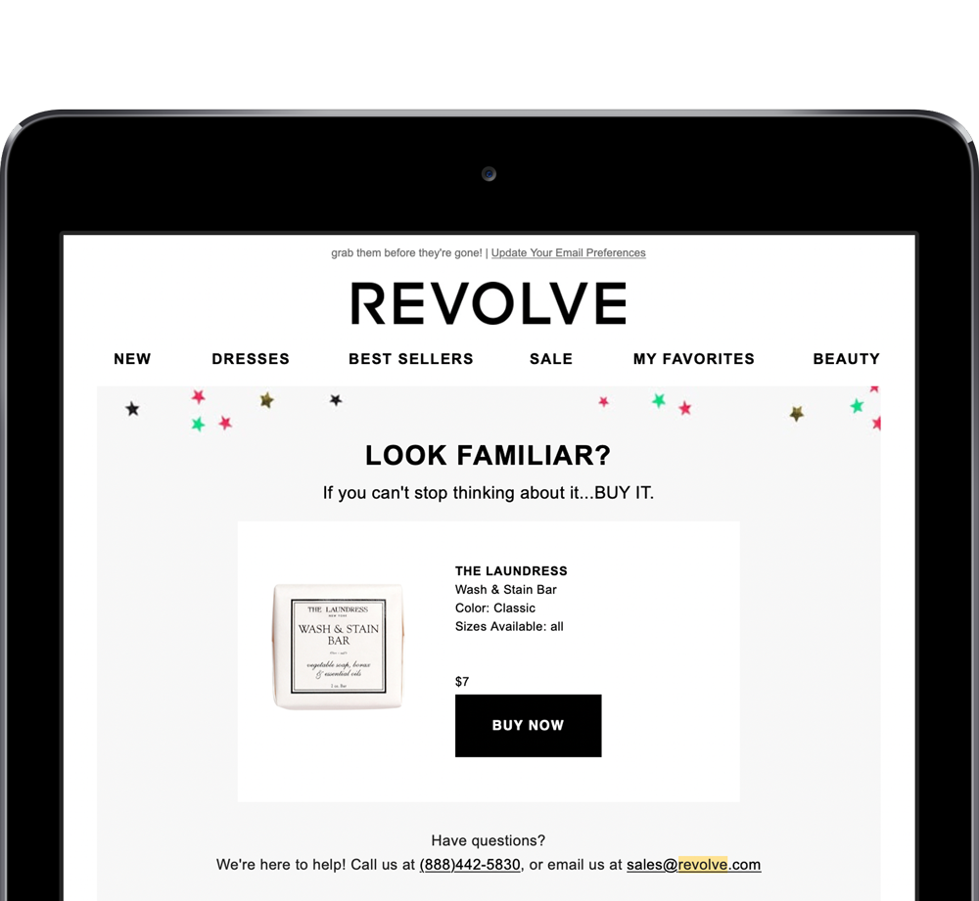
Abandoned carts
Build thoughtful automated trigger campaigns
Notes:
Abandon carts. Now most of you will have some form of abandon cart automation I’m sure – but is it doing its job in driving conversions and revenue otherwise missed out on?
Here’s a 2 stage abandon cart program from Revolve…
Subject line suggesting that other people were looking at the same product that the user had in their cart, creating social proof/ Urgency
They then offered product recommendations tied to what was in the cart.
AND…..What better way to re-engage than by prompting the customer via a timely channel? Skullcandy used SMS text messages to remind users about abandoned baskets, along with a link and a clear CTA.

Slide 20
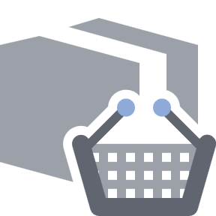
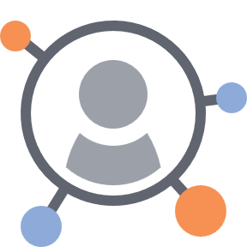
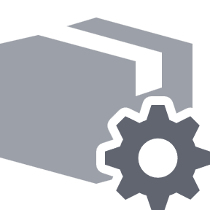
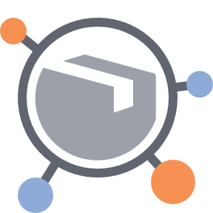
Product recommendations
General
AI
Best Sellers
Most Viewed
Also bought
Best next
Trending
Custom category
Lookalikes
Notes:
Product recommendations are a Commerce-favourite, a proven way for marketers to increase sales effortlessly and give visibility to their product range across all marketing campaigns. I’m sure many of you are already doing this in some capacity.
In Dotdigital, marketers can easily drag and drop a variety of product recommendations into any email campaign. Each product recommendation can then be filtered to further customize what products are shown (f.e. female running shoes for less than £100).
AI-powered product recommendations: Our machine-learning model looks at huge data sets, identifies patterns, and makes predictive recommendations based on what customers are most-likely to purchase next – ultimately turning lights on in a room you never knew you had.

Slide 21
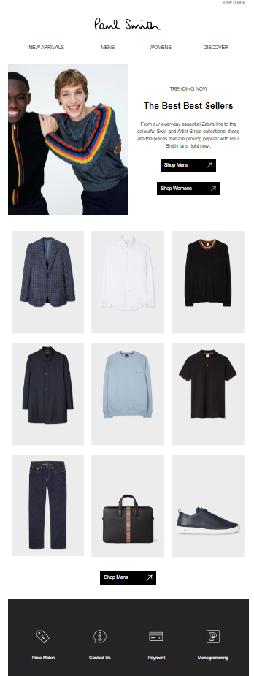
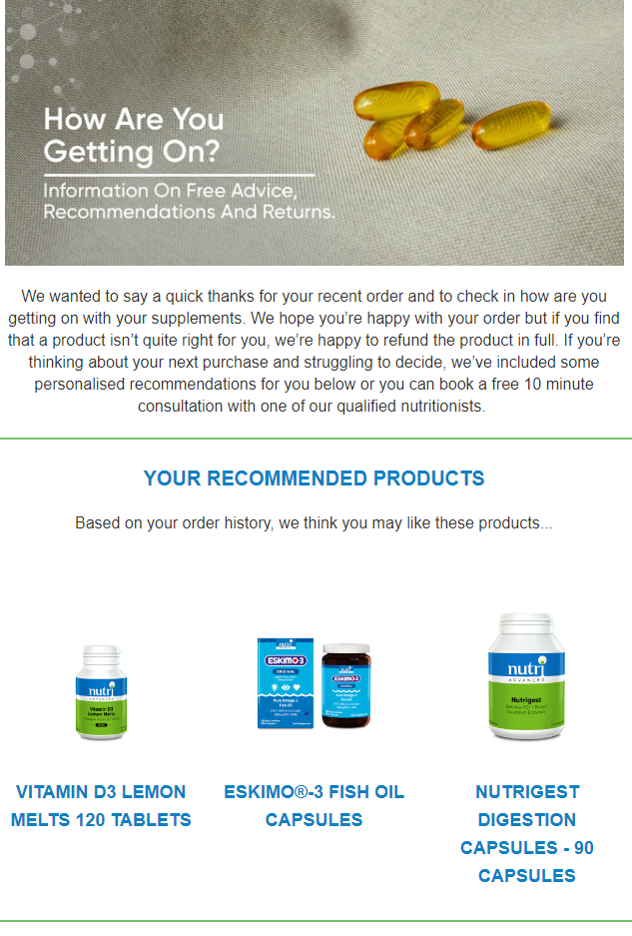
Product recommendations
Notes:
Philip Kingsley using purchase data to suggest repeat purchasing.. And they use a GIF which just makes that headline offer pop.
Nutri-advance have sent a timely follow up to a recent purchase to suggest lookalike products for cross sell
Paul Smith are showcasing some best sellers. (useful for welcome programs with no prior purchase data, and products always relevant at point of sign up)

Slide 22
To conclude
Today’s customer expectations

Slide 23
Right message
Notes:
Right message
Right time
Right person
Right channel

Slide 24
Right message
Right time
Notes:
Right message
Right time
Right person
Right channel

Slide 25
Right message
Right time
Right person
Notes:
Right message
Right time
Right person
Right channel

Slide 26
Right message
Right time
Right person
Right channel
Notes:
Right message
Right time
Right person
Right channel
And that’s still SO relevant to what we’re all trying to achieve.
But since Covid, society’s changed, and has seen the need to adopt even smarter tactics or you risk disconnecting customers or losing out to competition.
So how have the expectations around the statement really evolved?

Slide 27
WAS
NOW
Right message
Nice content.
Nice design.
Personalised content. Always relevant.
Right time
Right person
Right channel
Notes:
Before – campaign content is on point. It looks good
Now – the need for personalised content to ensure all campaigns are relevant

Slide 28
WAS
NOW
Right message
Nice content.
Nice design.
Personalised content. Always relevant.
Right time
11am on Tuesdays!
Automations triggered using customer data.
Right person
Right channel
Notes:
Before – the optimum send time for me is 11am Tuesdays
Now – the right time for each person based on a particular data source or behavioural trigger

Slide 29
WAS
NOW
Right message
Nice content.
Nice design.
Personalised content. Always relevant.
Right time
11am on Tuesdays!
Automations triggered using customer data.
Right person
Segmented contacts.
Dynamically driven segments, RFM, Affinity scores.
Right channel
Notes:
Before – send to my top performing segment
Now – need to target all dynamically driven segments using RFM and affinity scores

Slide 30
WAS
NOW
Right message
Nice content.
Nice design.
Personalised content. Always relevant.
Right time
11am on Tuesdays!
Automations triggered using customer data.
Right person
Segmented contacts.
Dynamically driven segments, RFM, Affinity scores.
Right channel
Email, email and more email.
Email plus SMS, WhatsApp, Social and Live Chat.
Notes:
Before – all about email – email for everyone
Now – need to be speaking to customers on the best channel for them – SMS whatsapp, social, chat

Slide 31
Thank you
dotdigital.com
@dotdigital.com
Notes:
Thank you for your time today. More info can be found on our website – or come speak to the team. (Get the team to wave/intro them)

